Slide 1
[mutual ground]
The final report

Slide 2
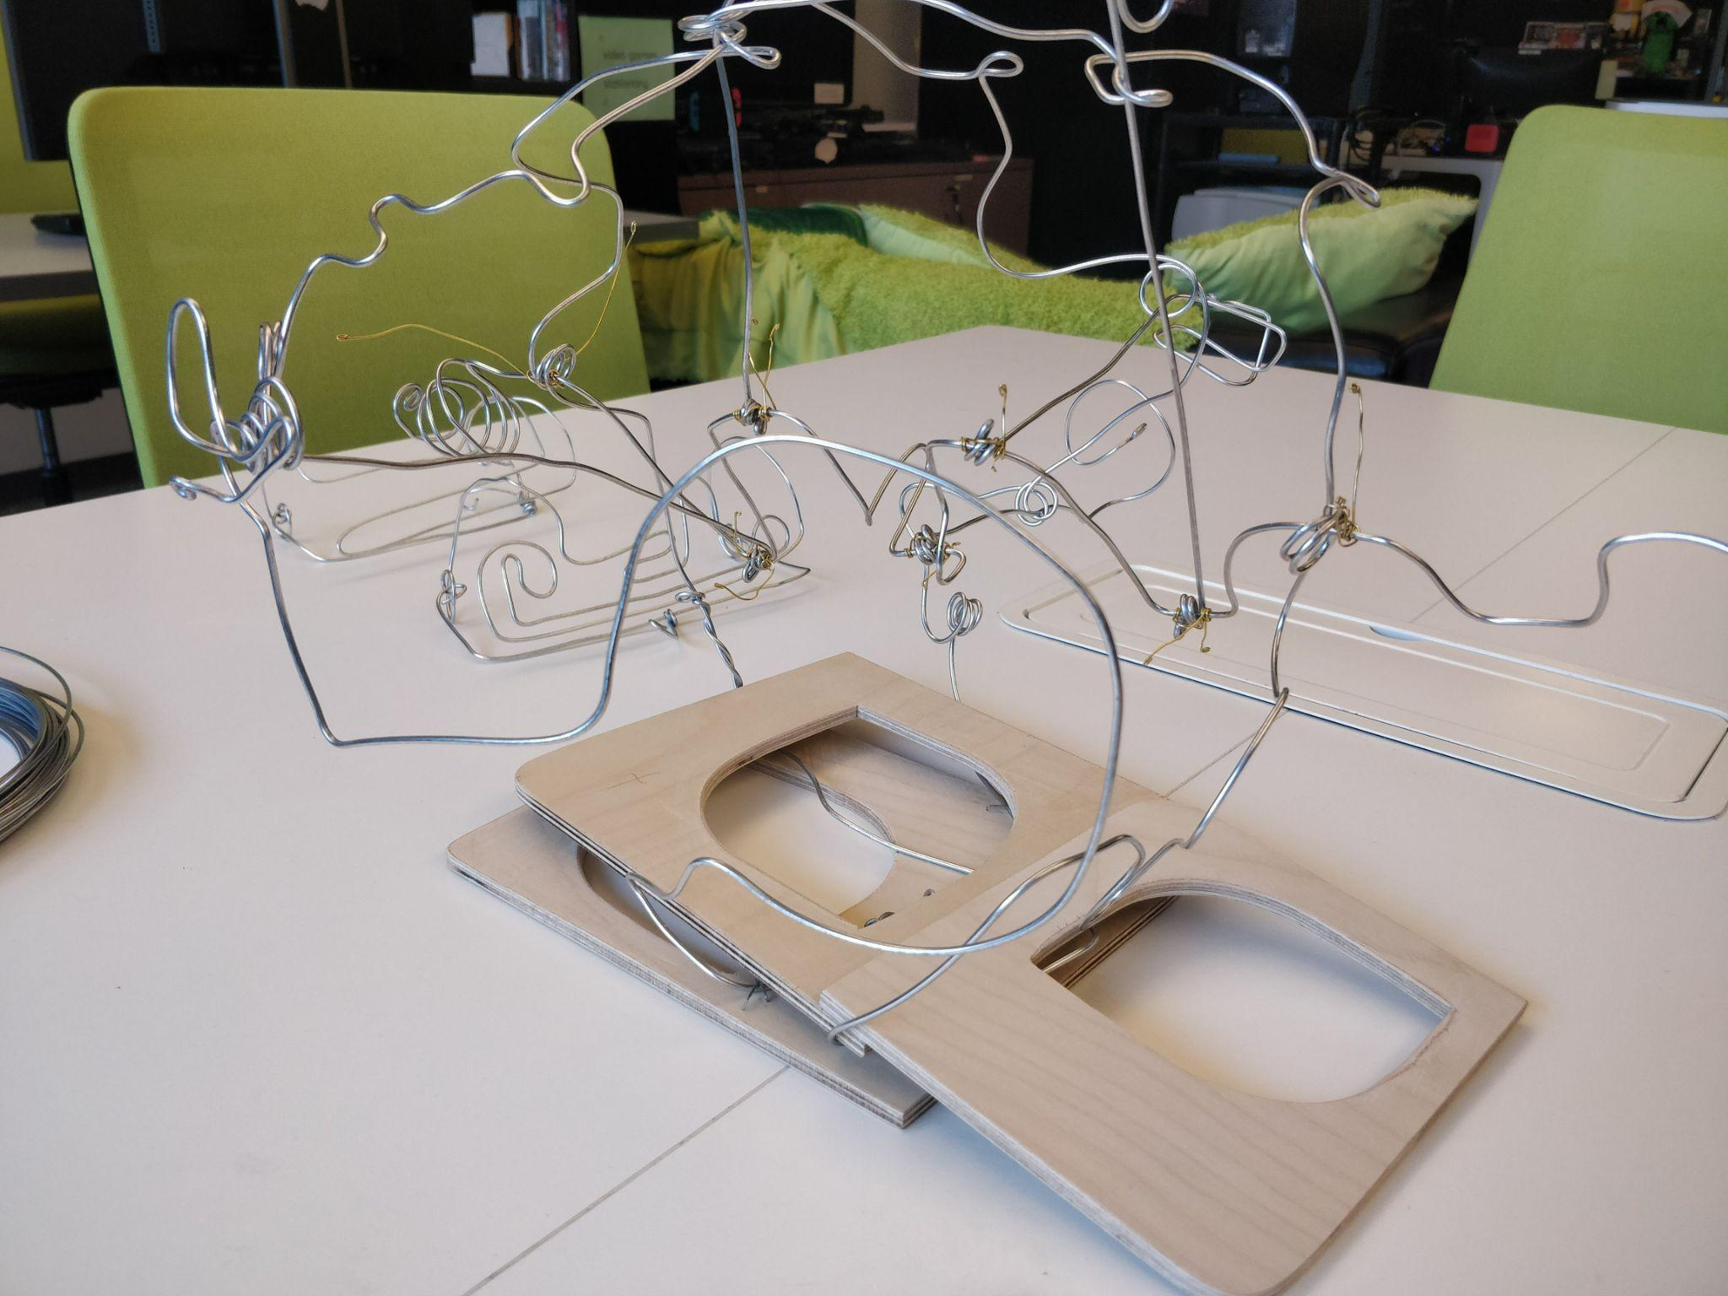
EVERYWHERE – abstract
To socialize and exist as a individual participant within a society requires a lingua franca – a shared means of communication. To socialize, to form connections with people outside of yourself, to put yourself out there, comes with misunderstandings and assumptions and uncomfortability. This piece comes out of a desire to explore the making of a tangible lingua franca, an abstract means of communication that encapsulates all the challenges that come with it. The paper begins with the process of developing the artifact, the final artifact, observations, and future directions.

Slide 3
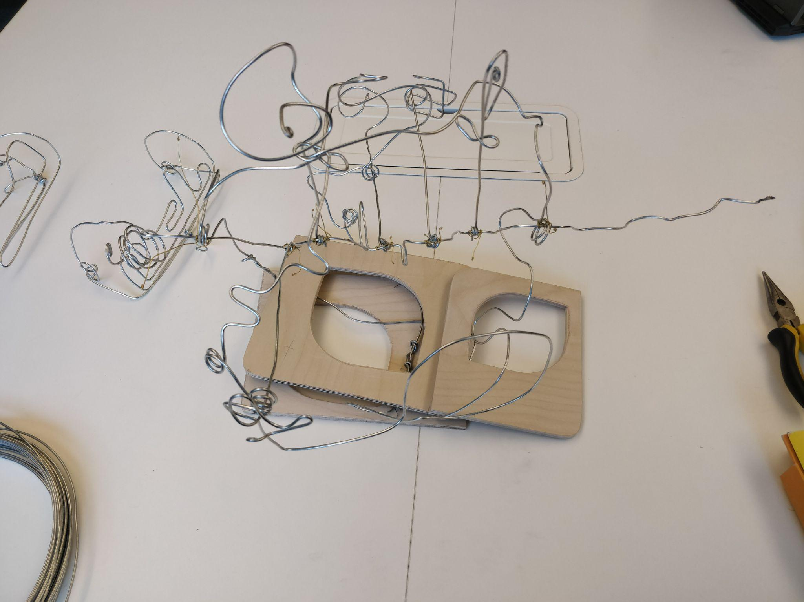
EVERYWHERE – abstract
[mutual ground] is an installation piece that intervenes in public and private spaces where it is displayed on an interpersonal-communications level. It can be seen as a specialized electronic device in the home or workplace, or a publicly available resource in an exhibition setting, meant to challenge the user’s conception of two-way streams of communication between people via an intimate & transformative physical contact interface.
The piece is meant to foster a conversation-type interaction among two people entangled in abstract sensorial communication with each other and the device, which reacts to input from muscle activity sensors placed in the users’ forearms. The device transforms sensor input into kinetic sculptural movement that can be experienced by touching the shifting surface of the artifact. Users are afforded a way of transmitting signals to each other through a mutual performance that encourages a breakthrough past the initial discomfort of physical touch needed to activate the device, into a type of understanding and collaboration.

Slide 4
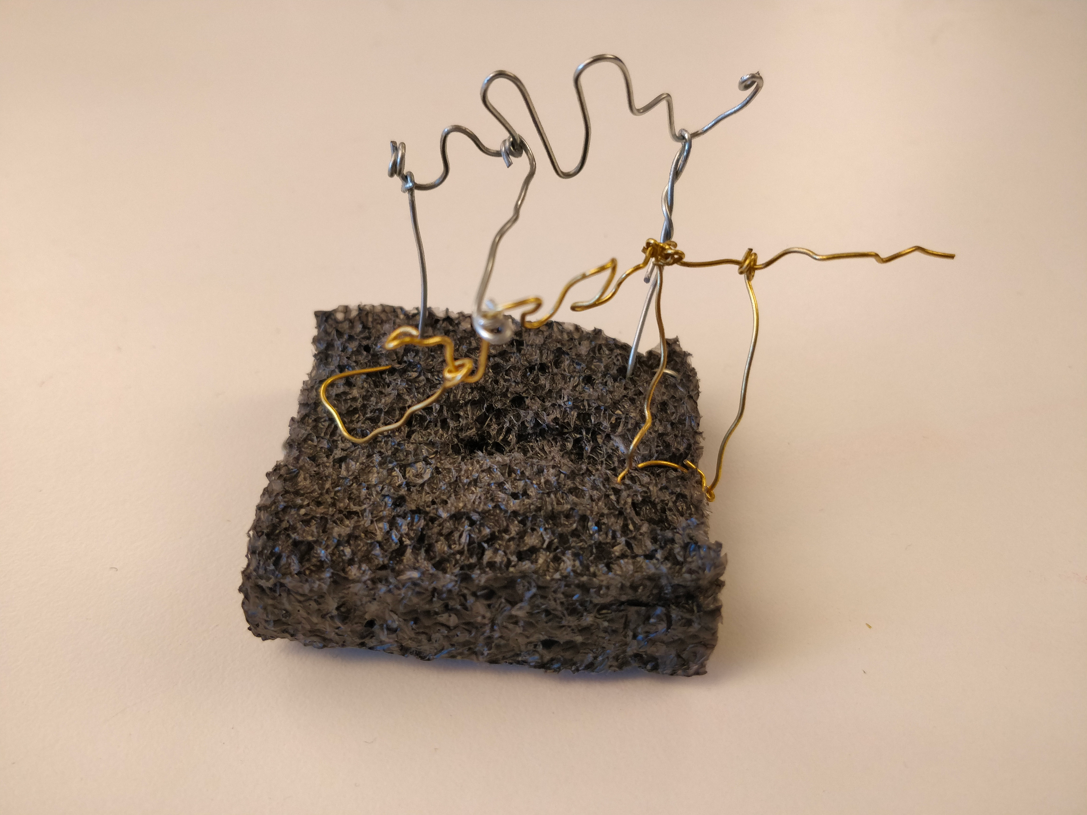
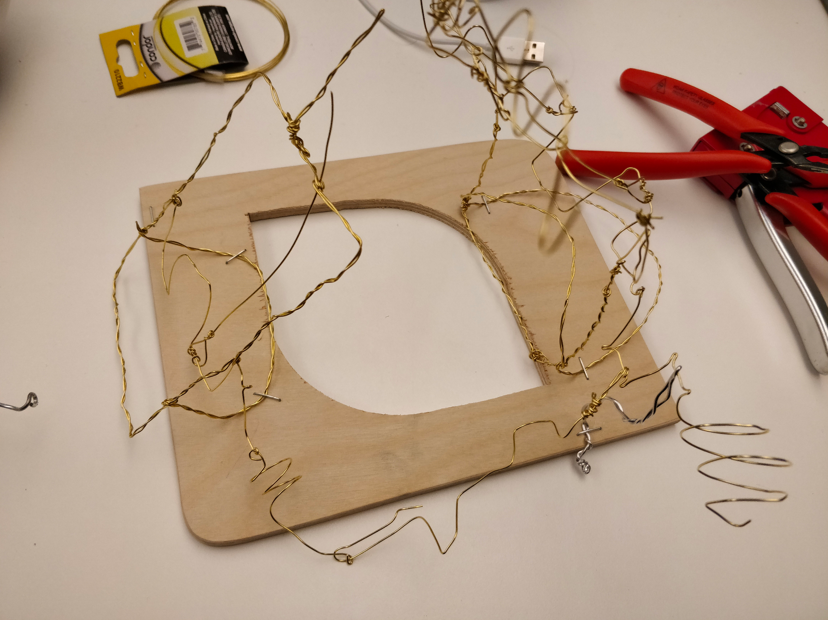
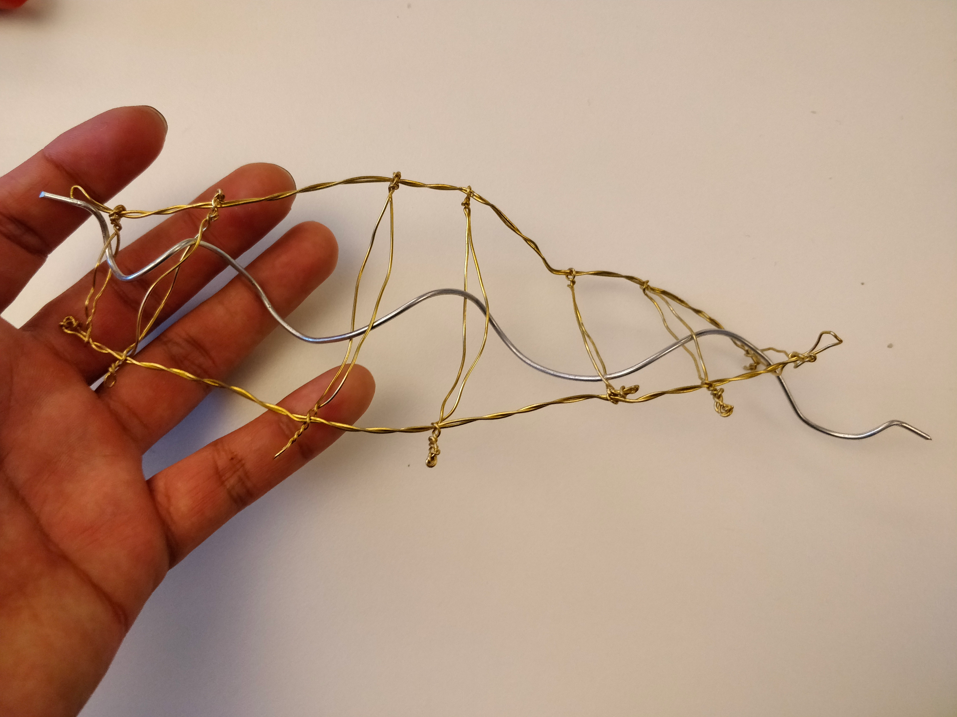
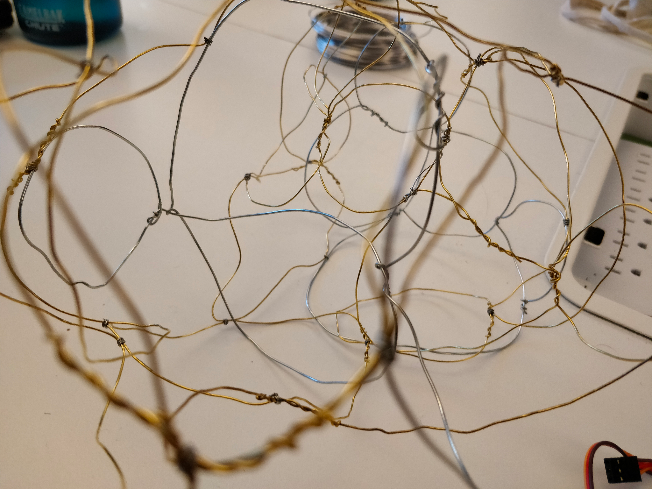
NOWHERE – Prototype Process
Sketching. Building. Wire exploration. Automata attempts on a small scale. Familiarizing with materials and movement. Exploring haptics, sculptures, cages, and cranks. By the time the prototype presentation rolled around, we learned that our current wire was not thick enough to strike the balance between structural integrity and malleability we wanted, and were lacking in actual computing.

Slide 5
NOW – Final Artifact
Initially, we were planning on relying on shared muscle sensors to power the automata crank but due to their unreliability, switched to capacitive sensors within the automata, as well as shared bracelets to maintain the physical contact.

Slide 6
Process videos
https://youtu.be/ekgDJwysuzA | [mutual ground] V2 - process vid 1
https://youtu.be/Q-nD2iNGlek | [mutual ground] V2 - process vid 2
https://youtube.com/shorts/65cno7eh0Z4?feature=share | [mutual ground] V2 - process vid 3
https://youtu.be/HoTxoNIX_C0 | [mutual ground] V2 - process vid 4

Slide 7
Interaction videos
https://youtu.be/klMMoPvIq_E | [mutual ground] V2 - interact vid 1
https://youtu.be/Qnx_4A49nms | [mutual ground] V2 - interact vid 2
https://youtu.be/16GgdXAtgSI | [mutual ground] V2 - interact vid 3

Slide 8
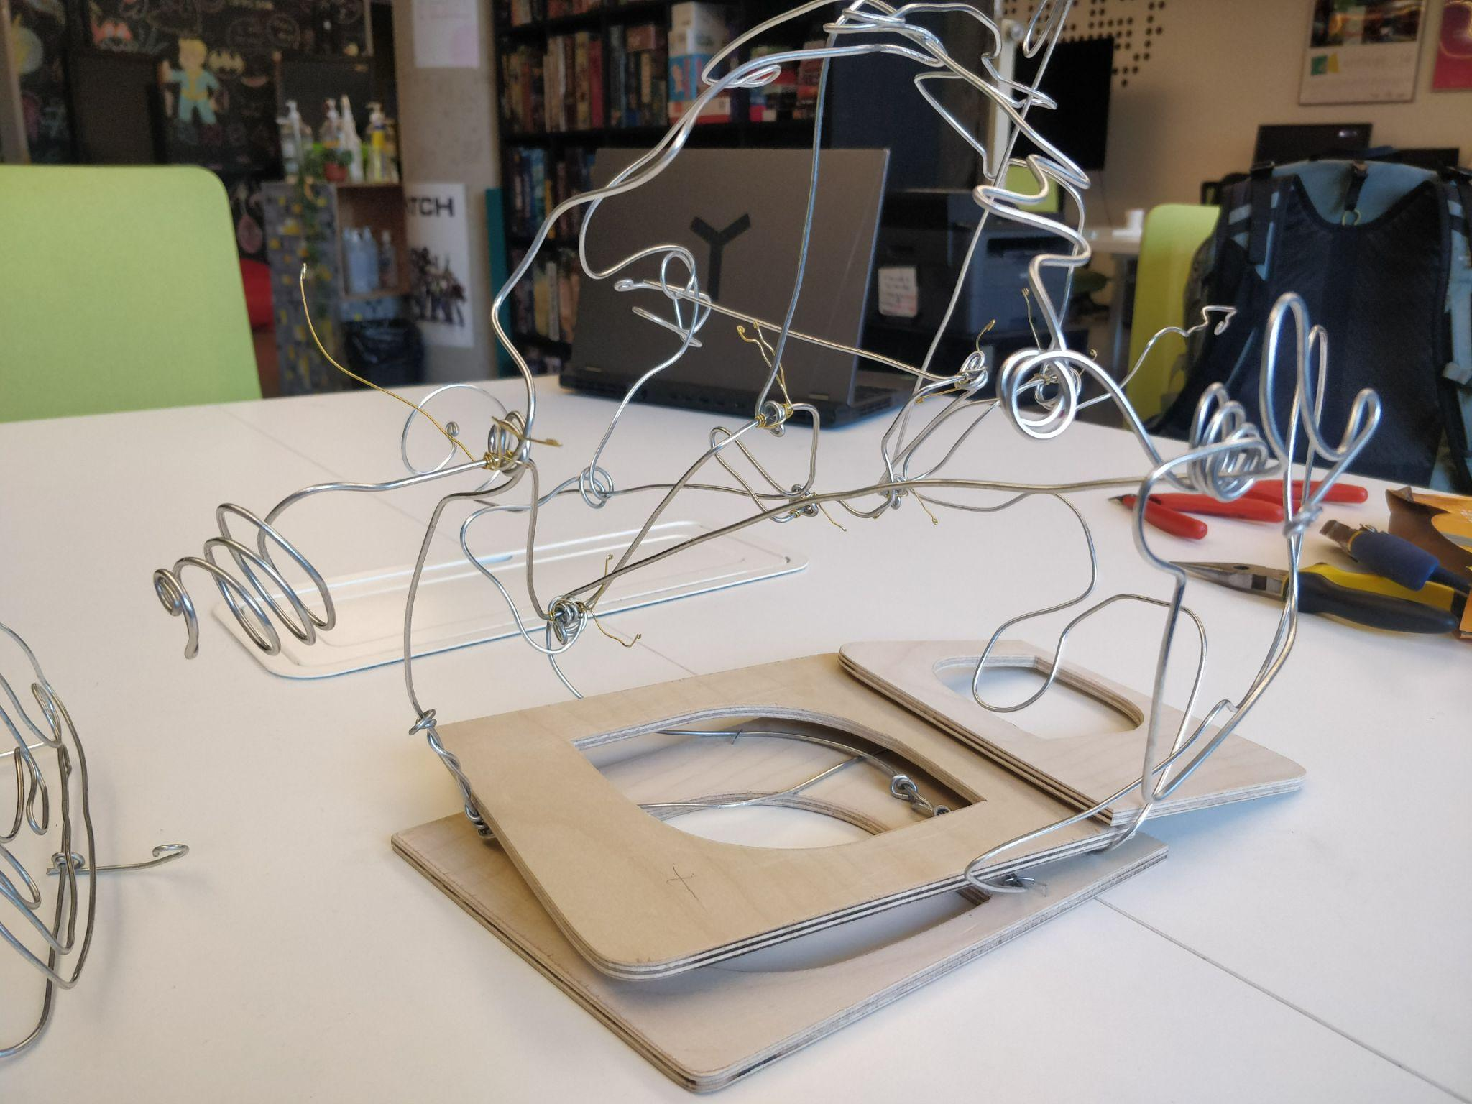

Slide 9
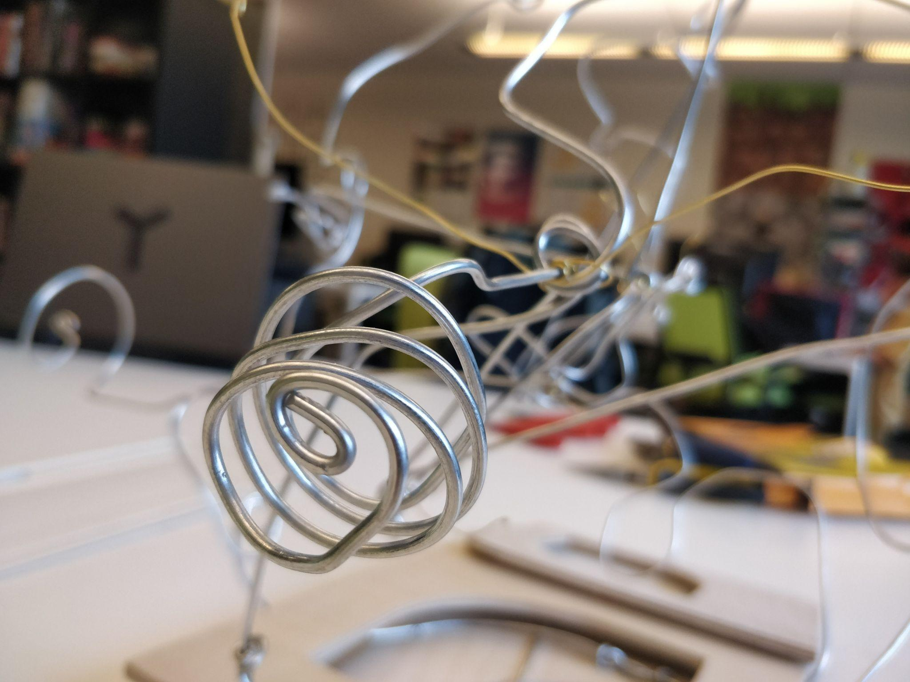

Slide 10
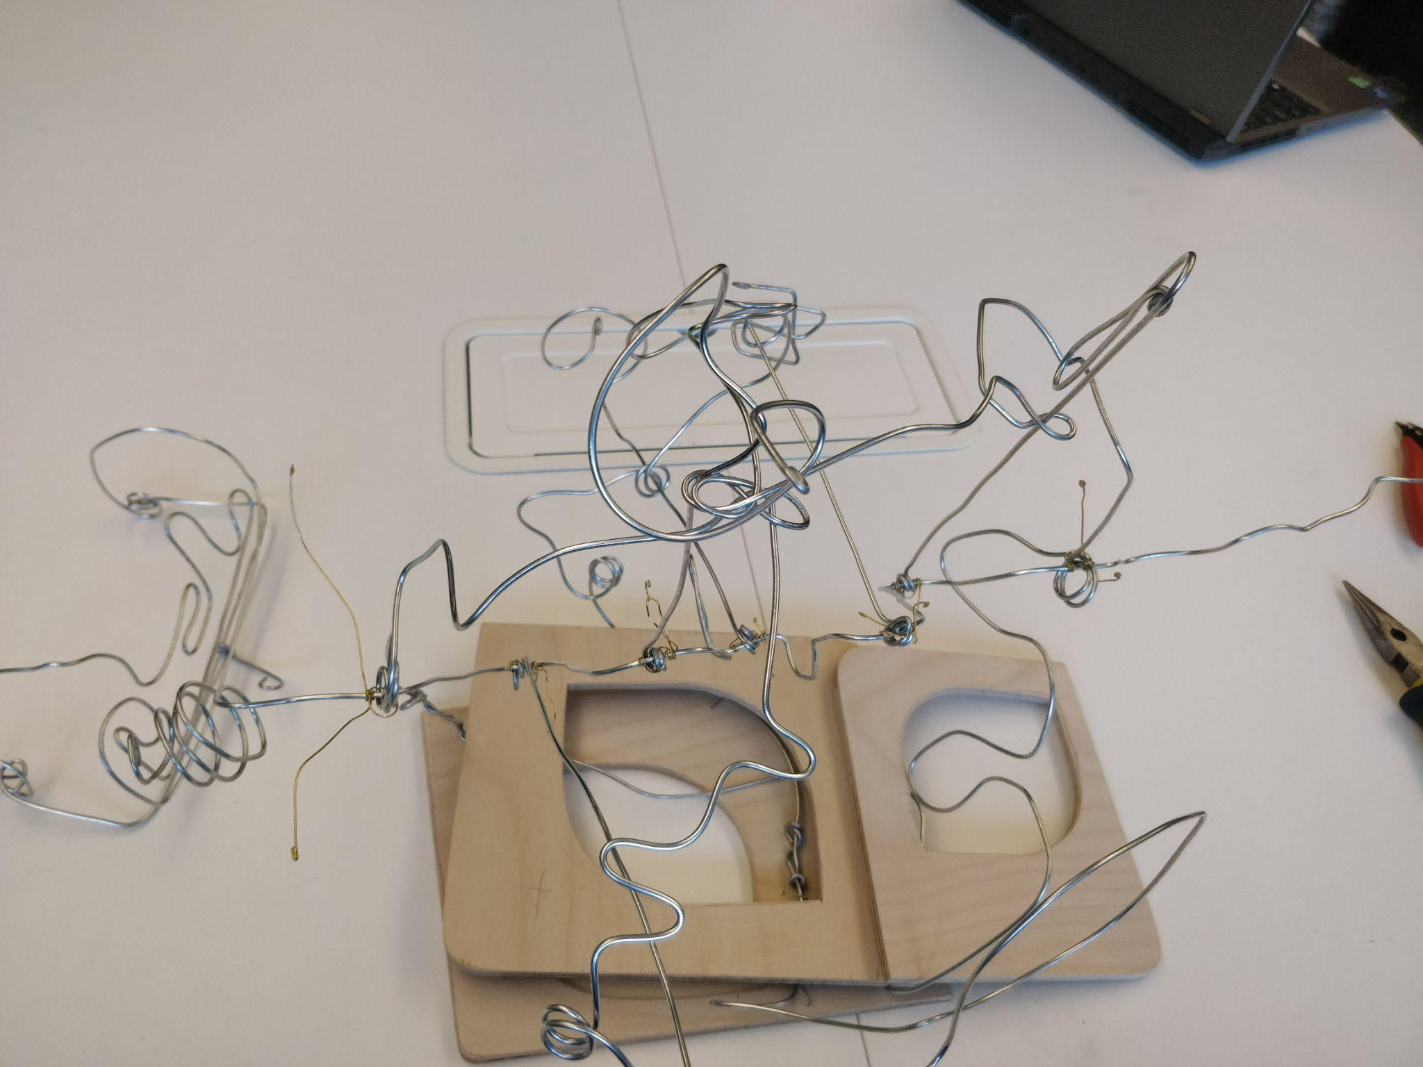

Slide 11
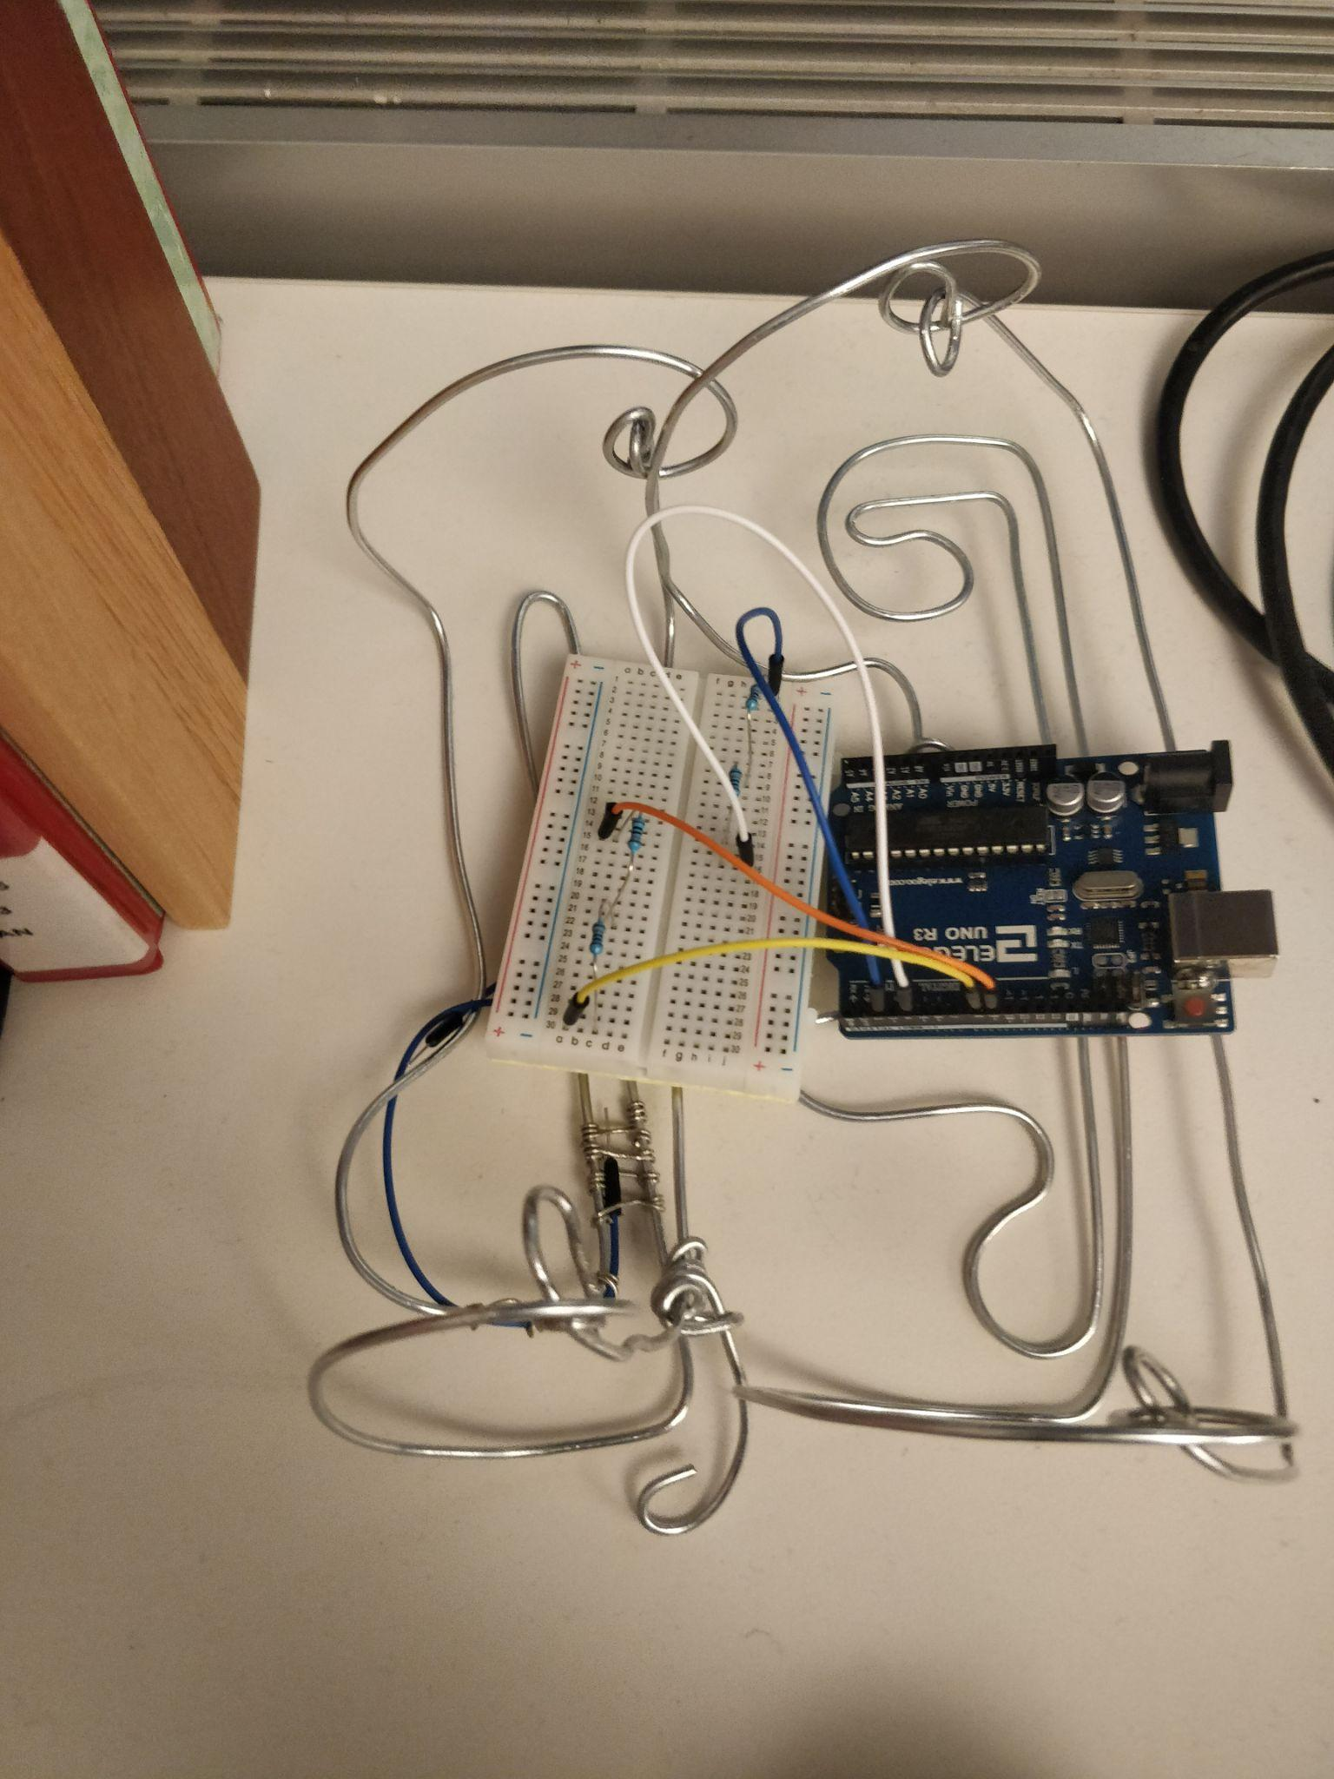
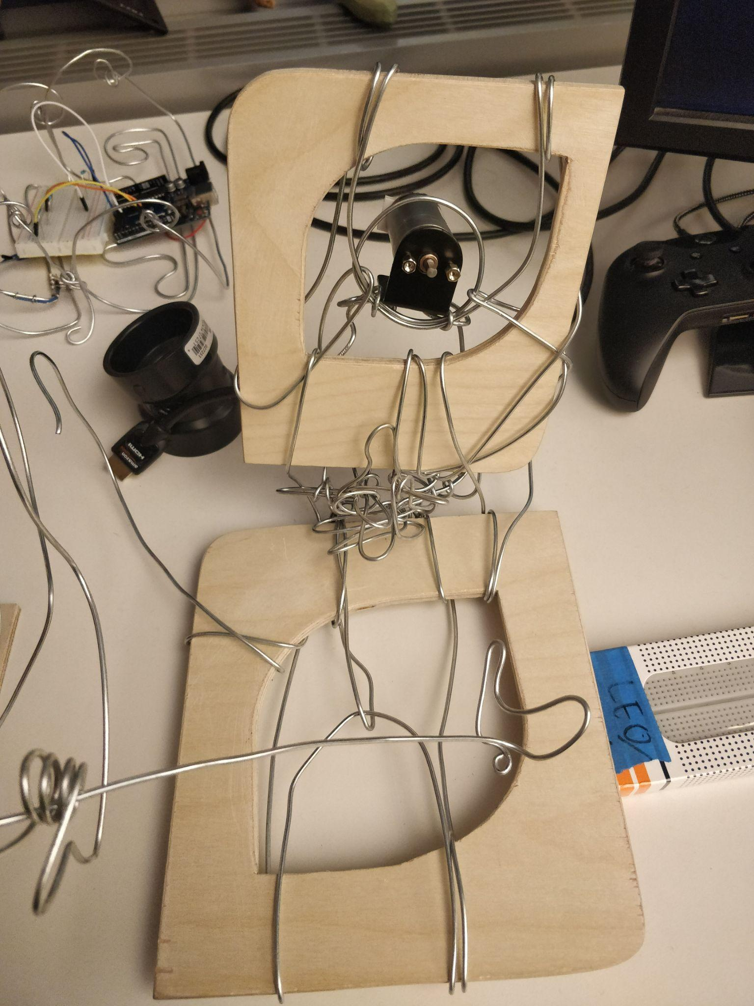

Slide 12
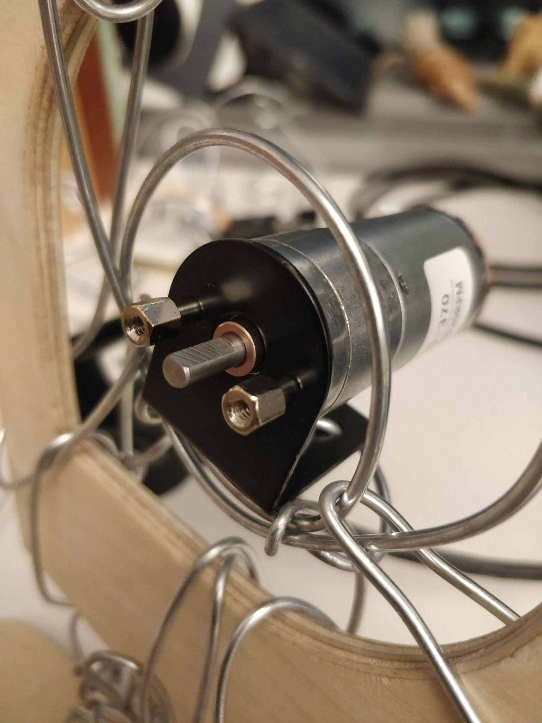
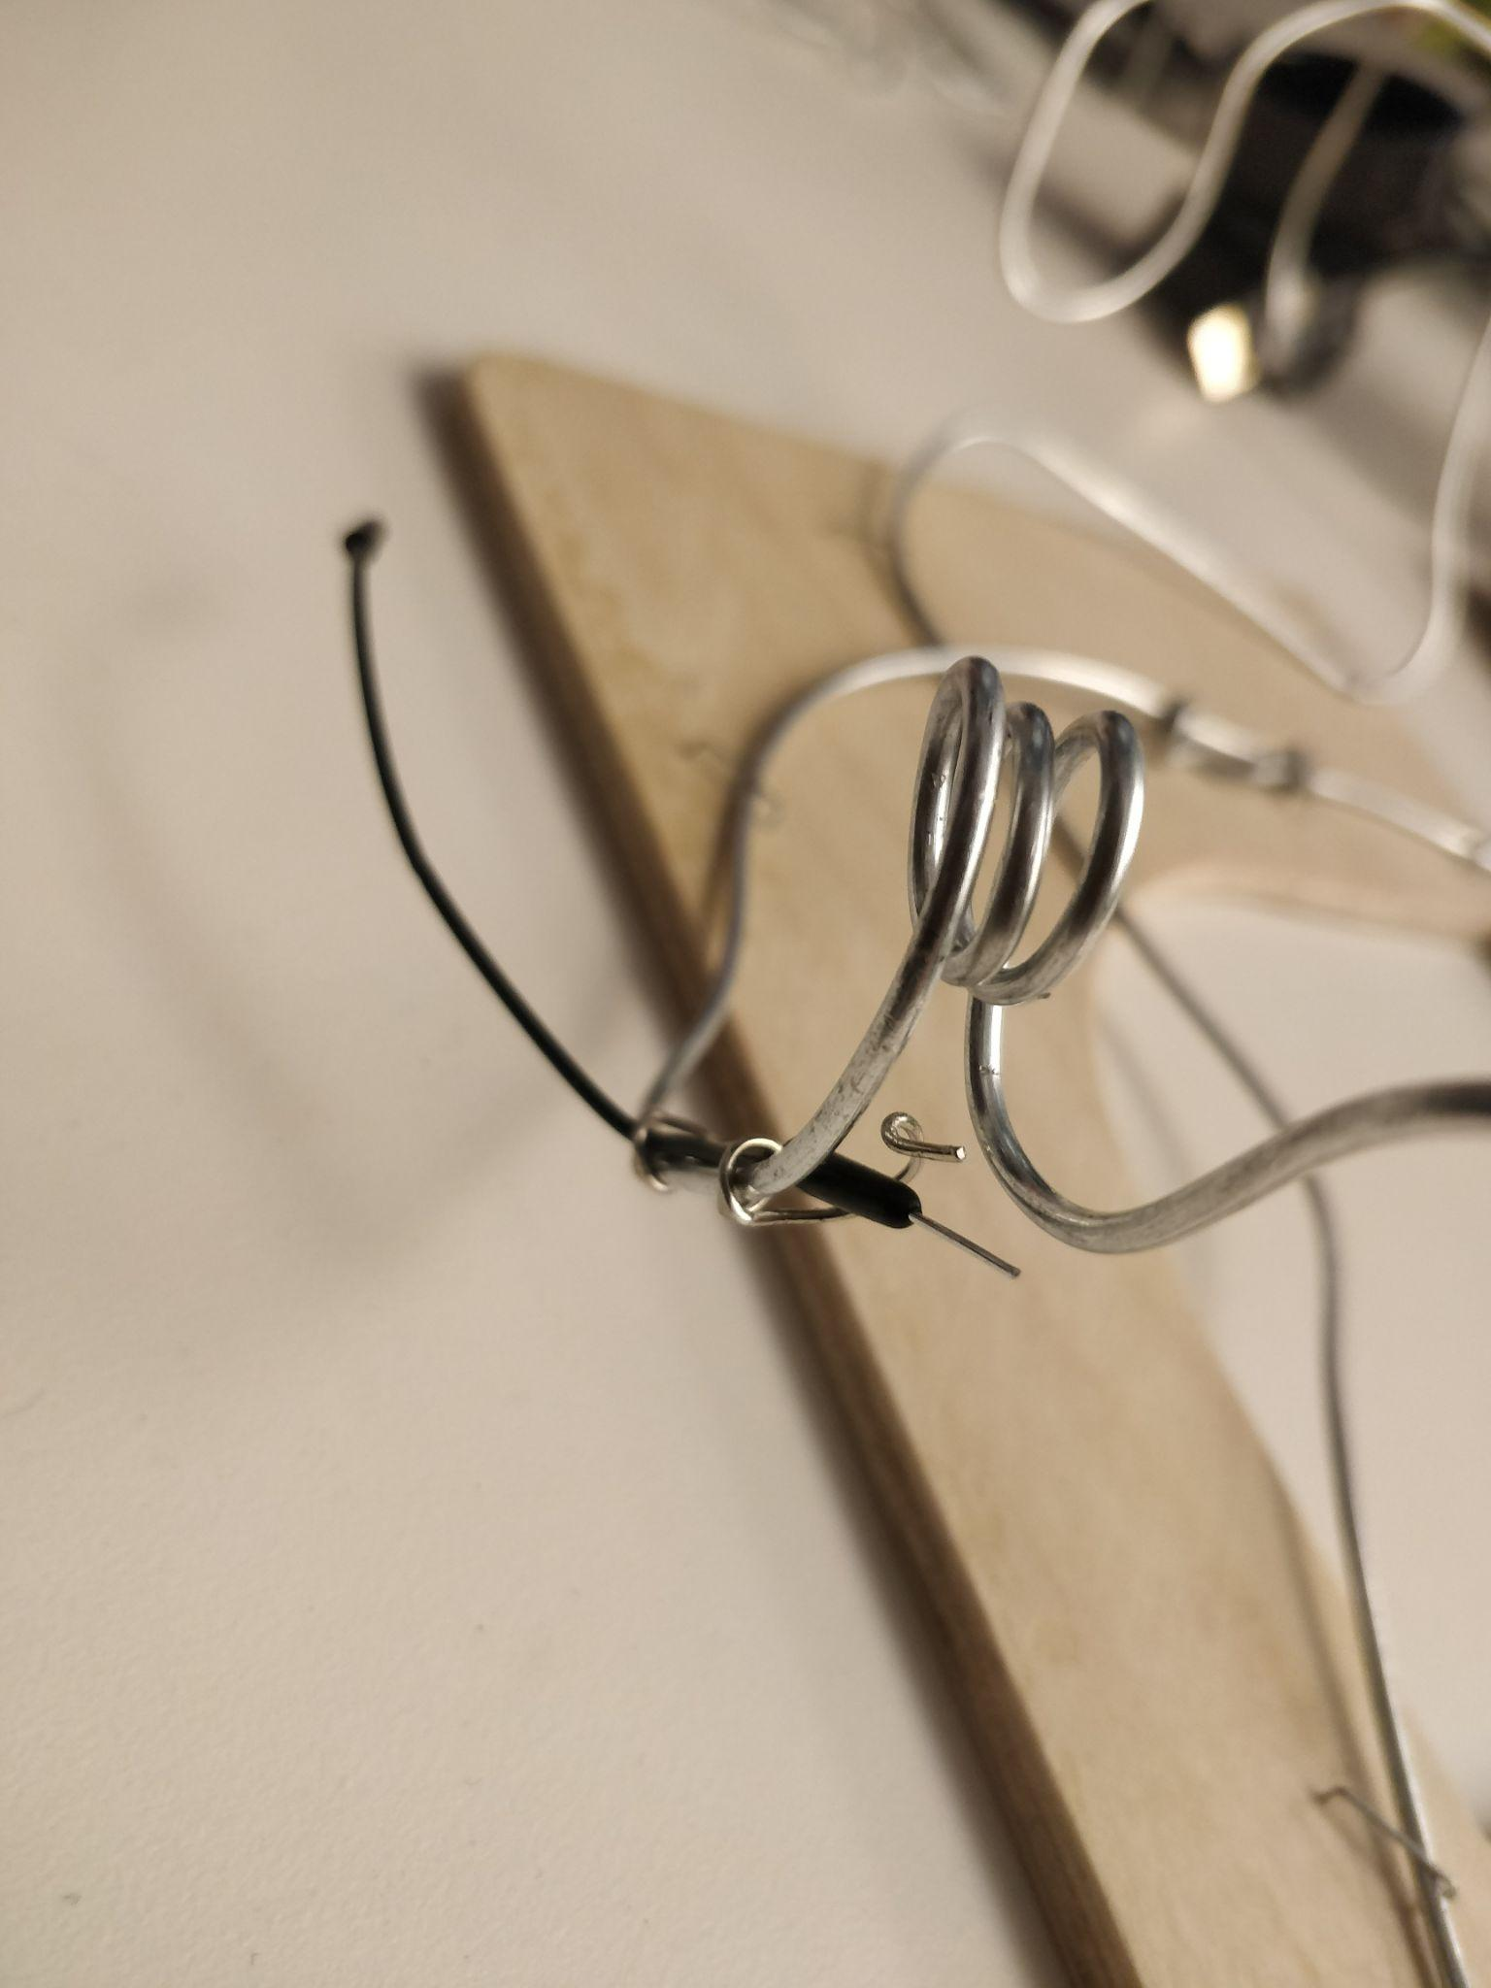

Slide 13
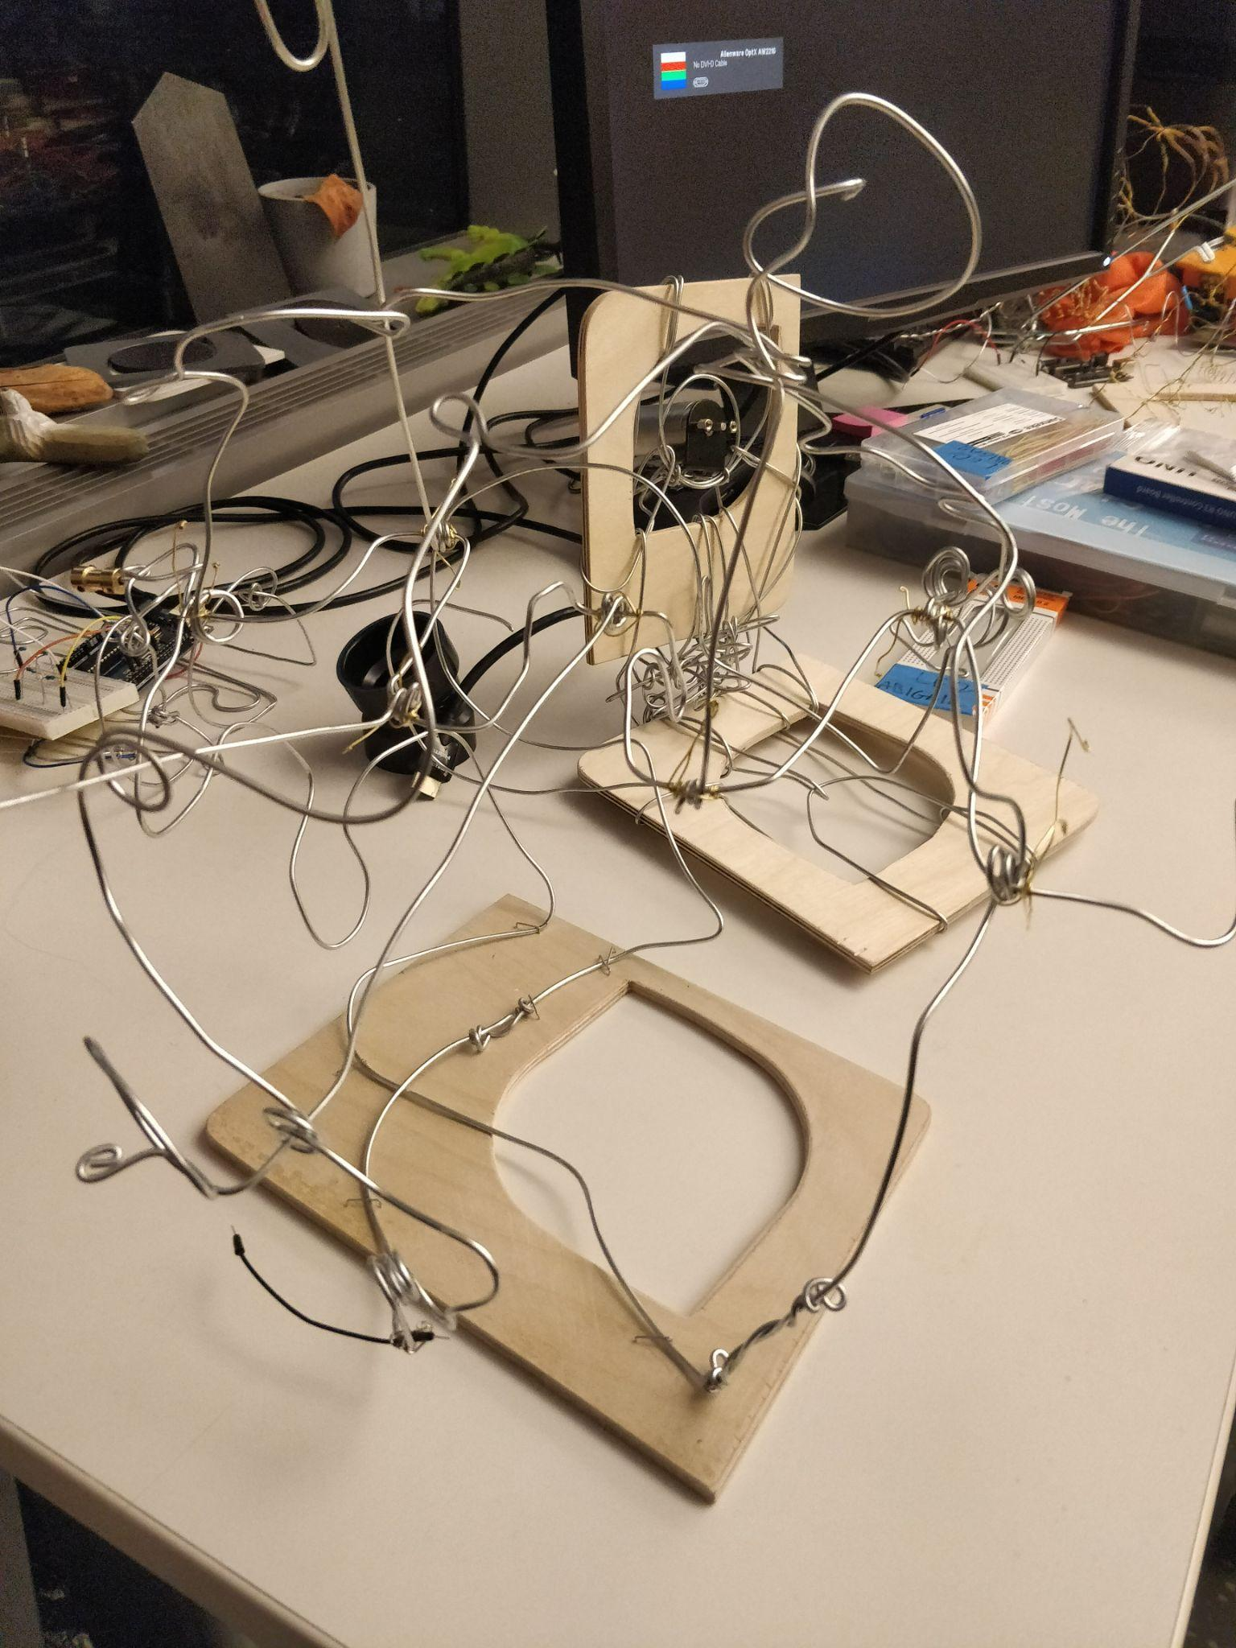
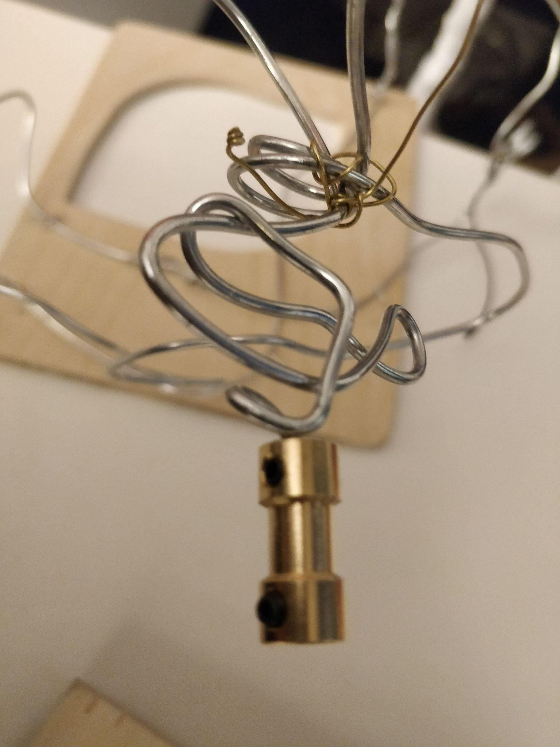

Slide 14
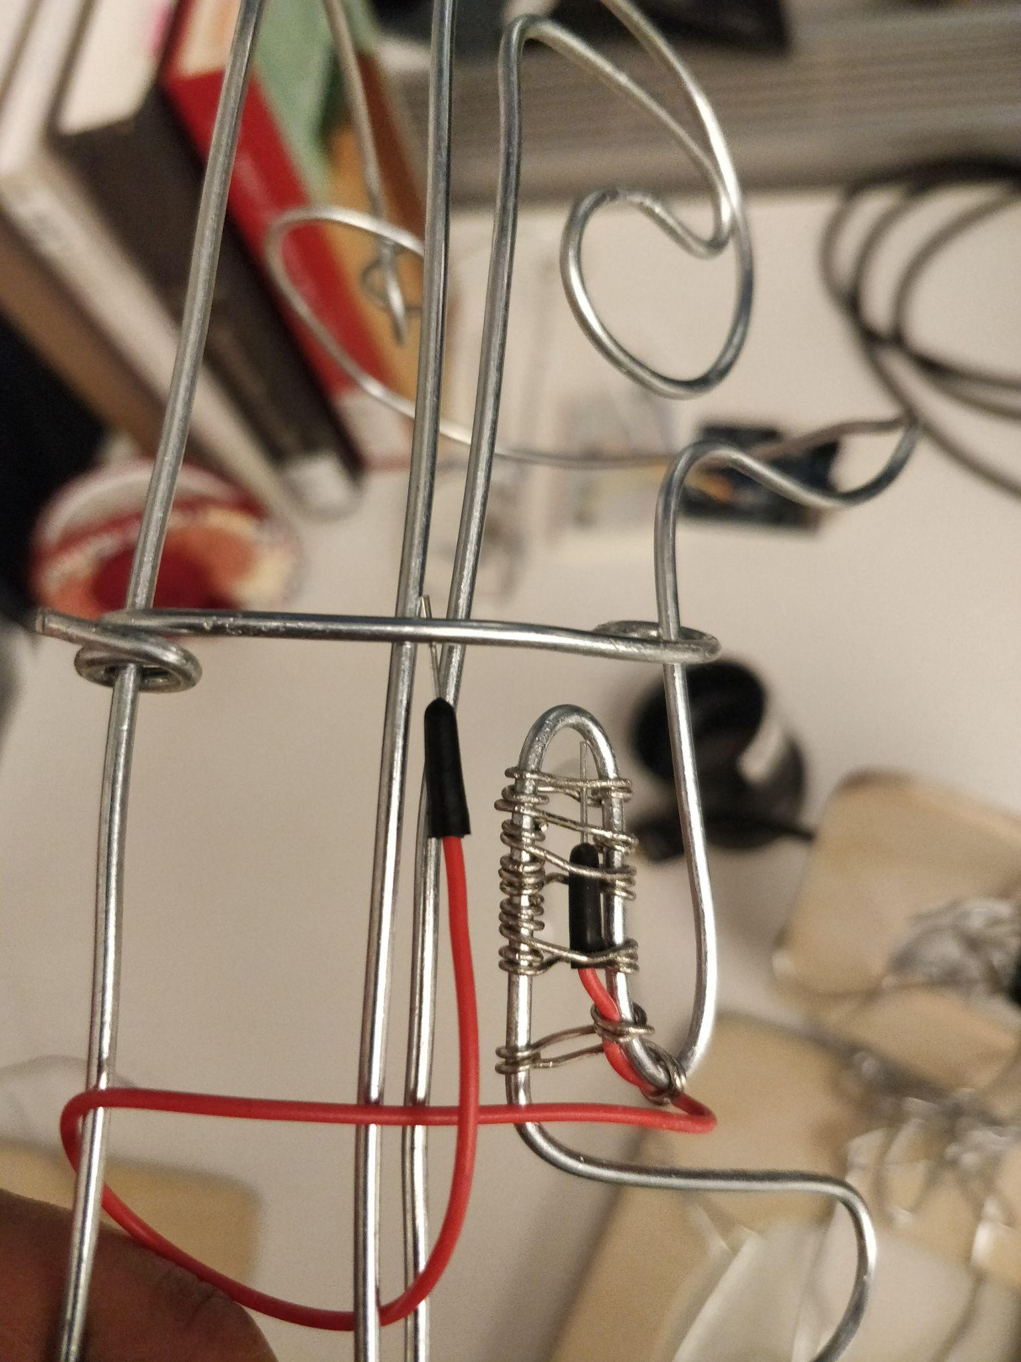
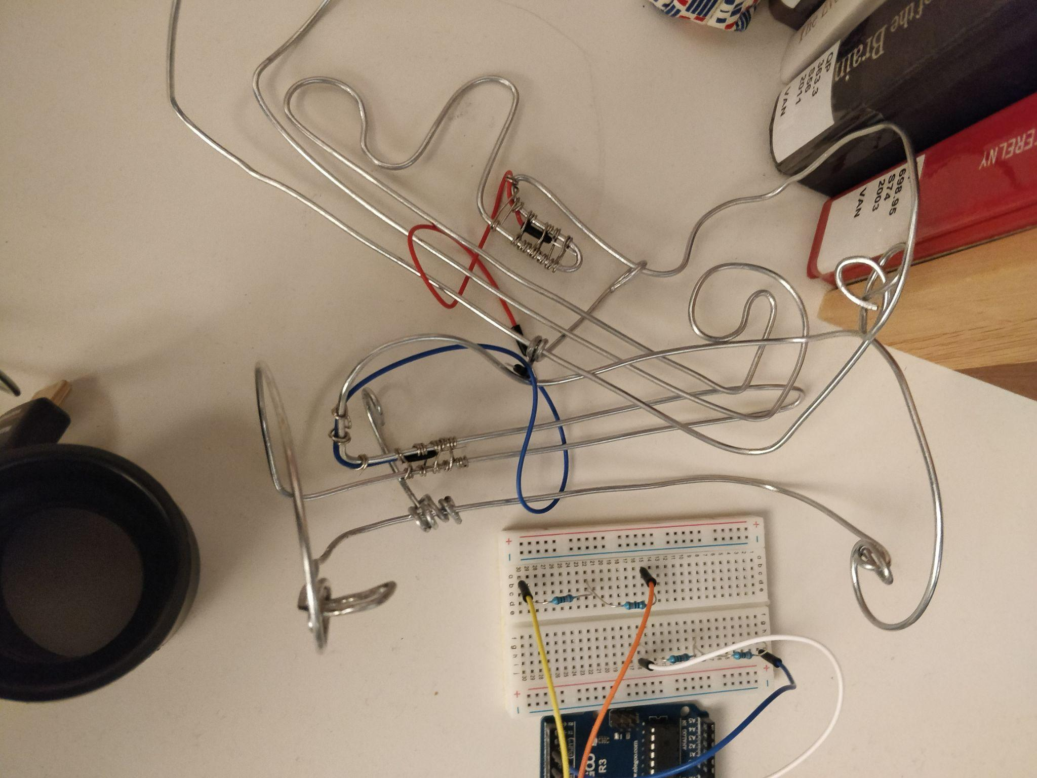

Slide 15
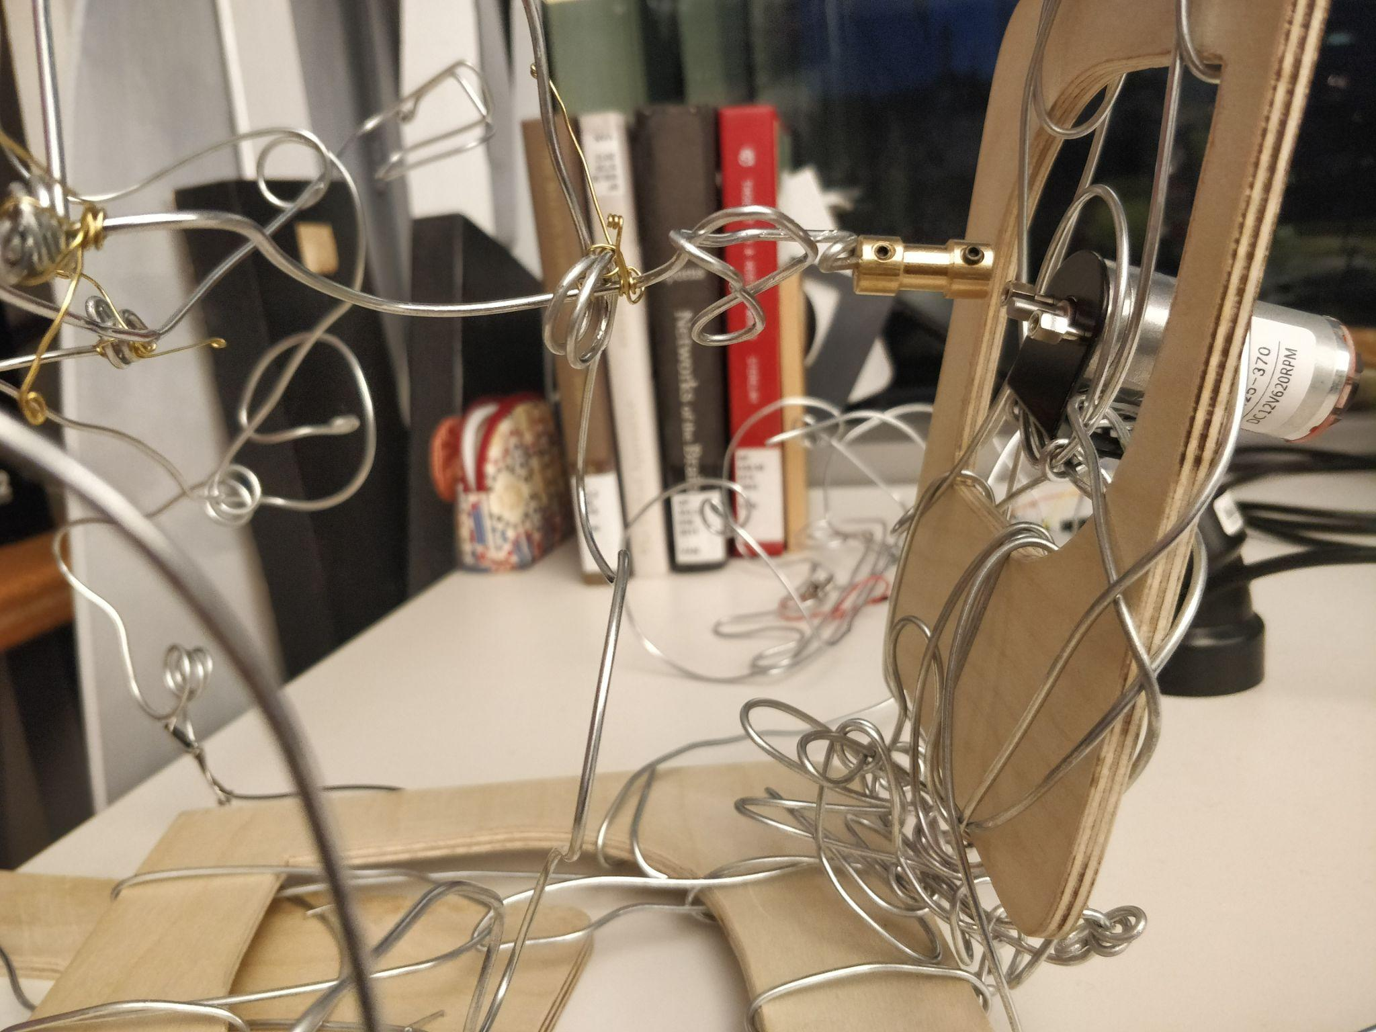

Slide 16
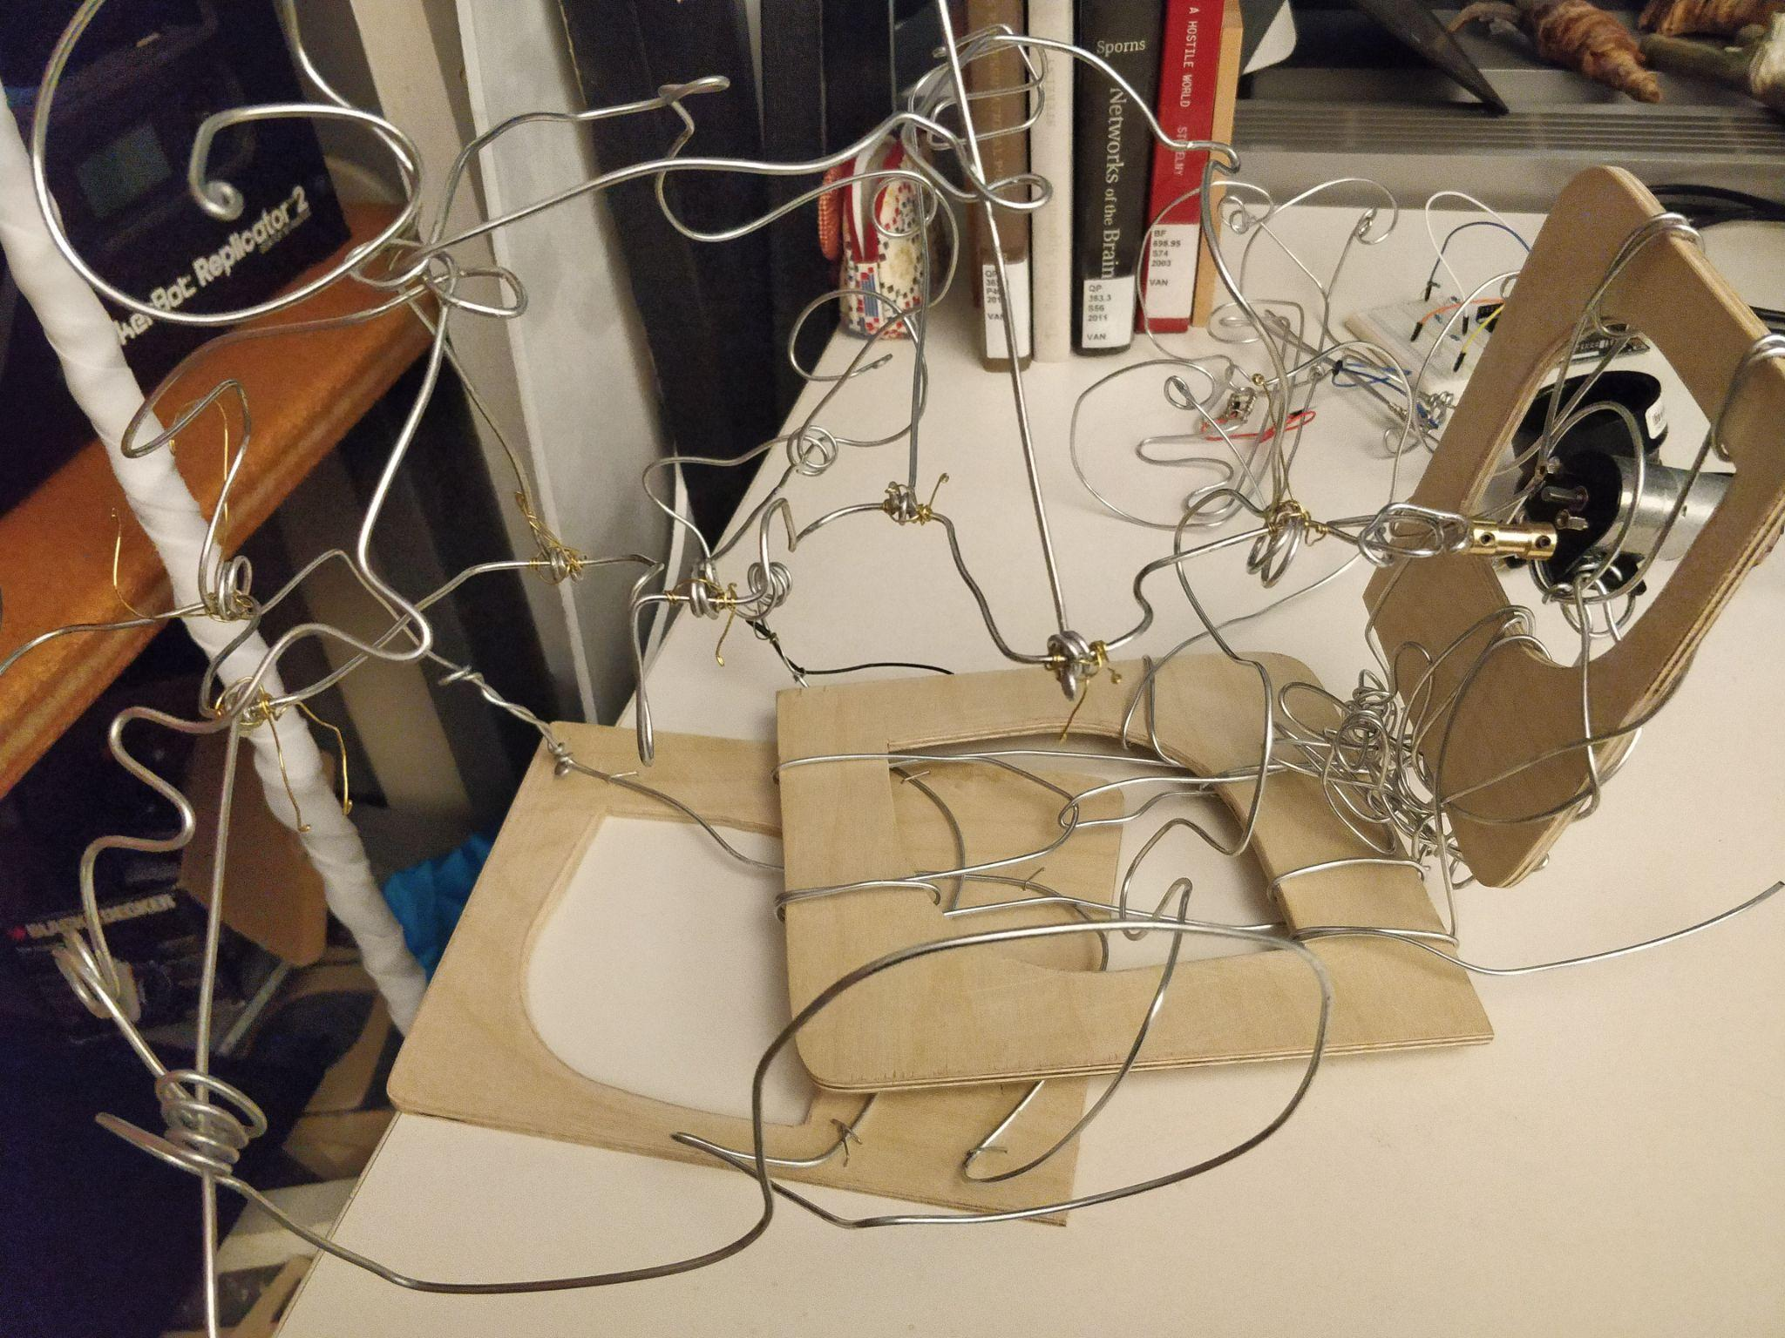

Slide 17
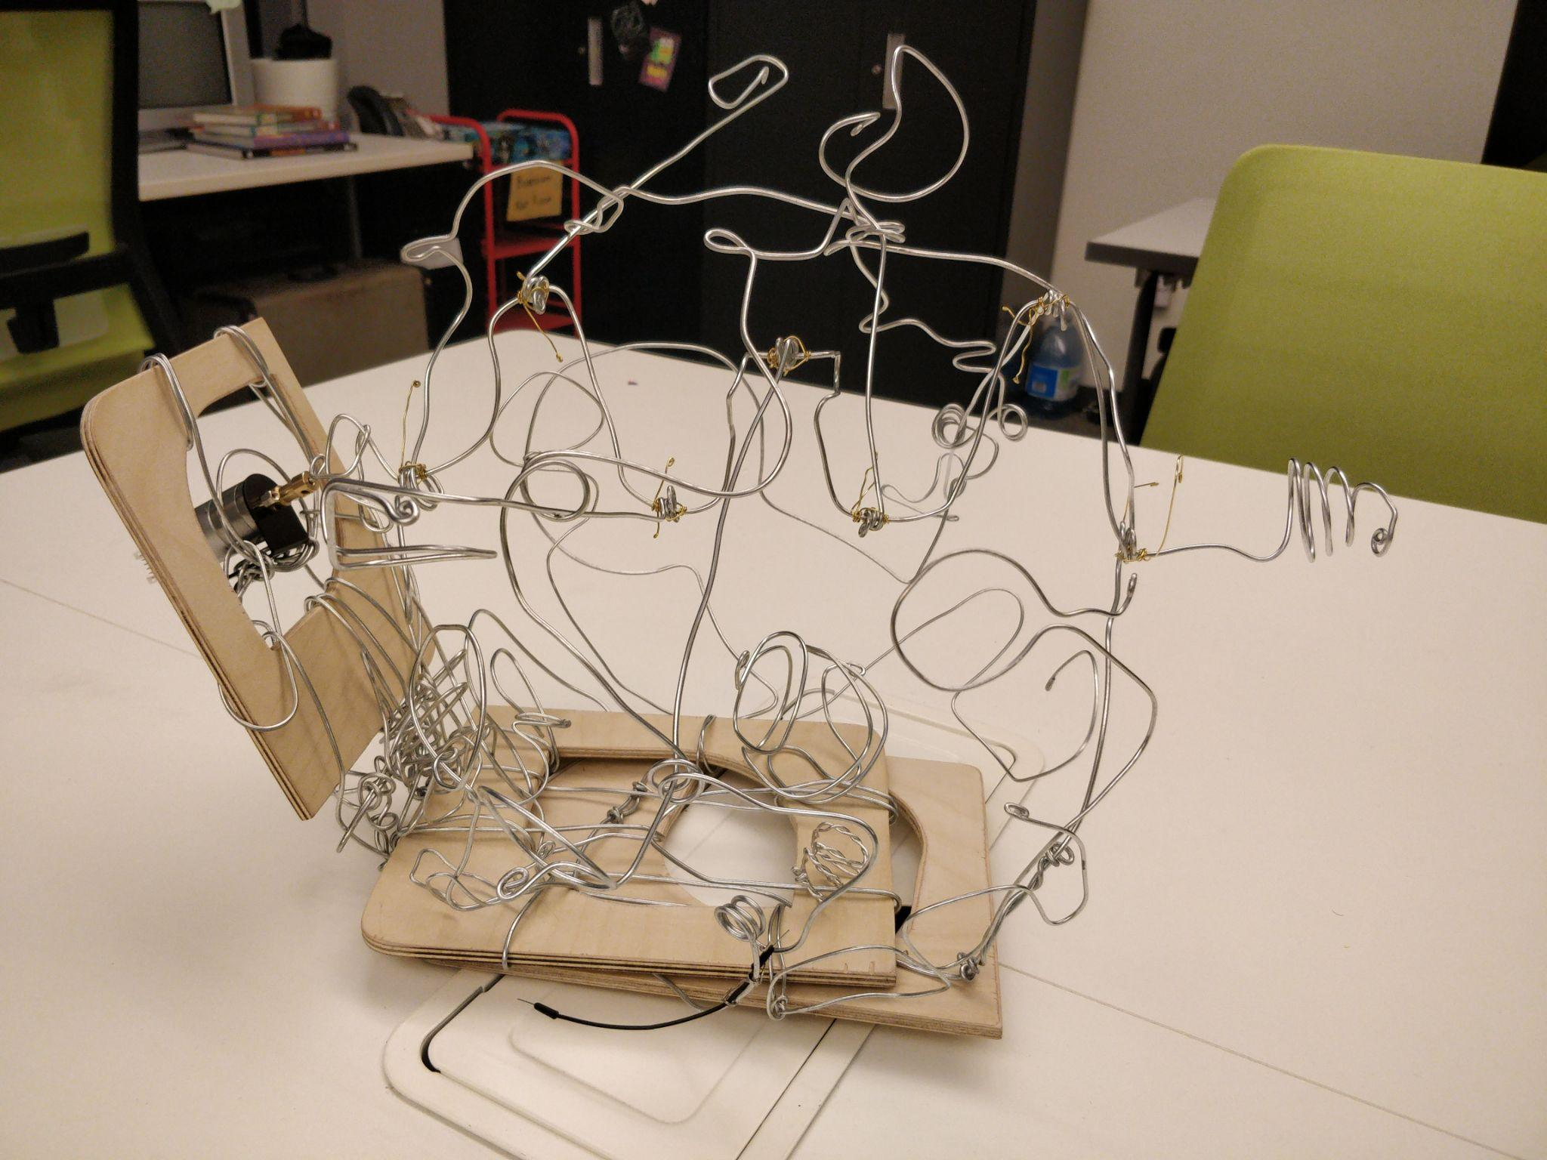

Slide 18
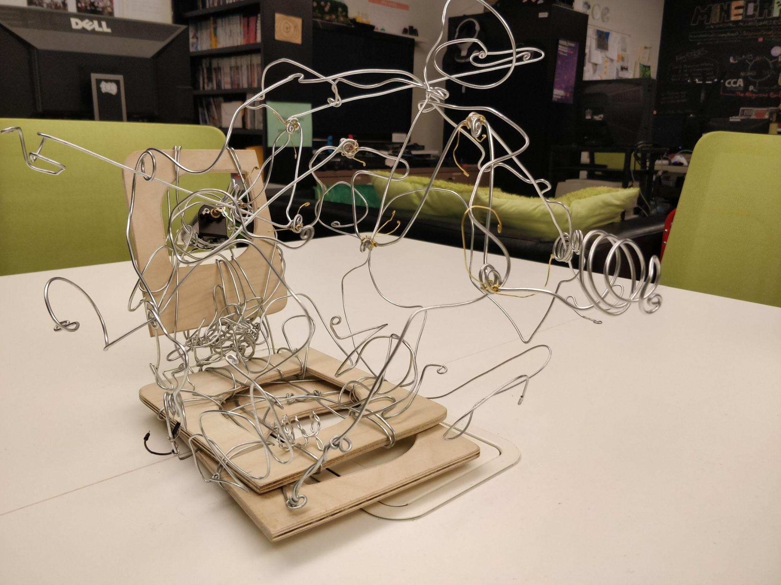

Slide 19
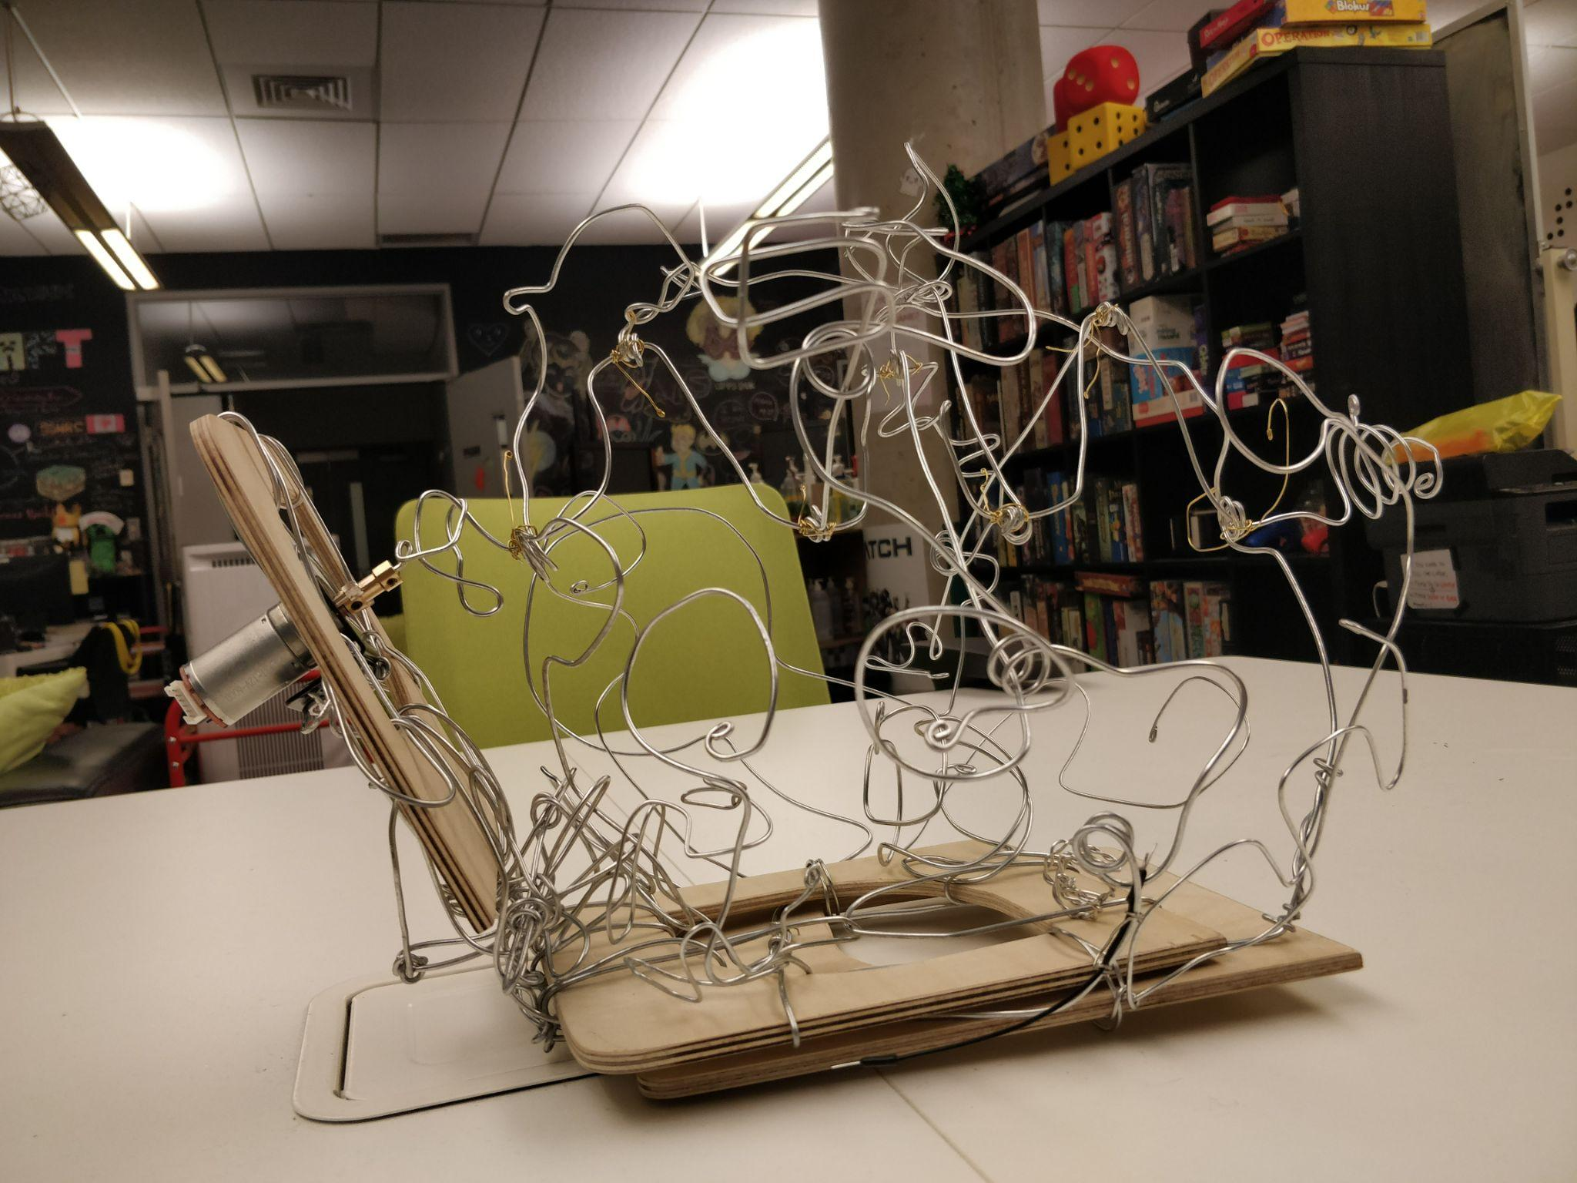

Slide 20
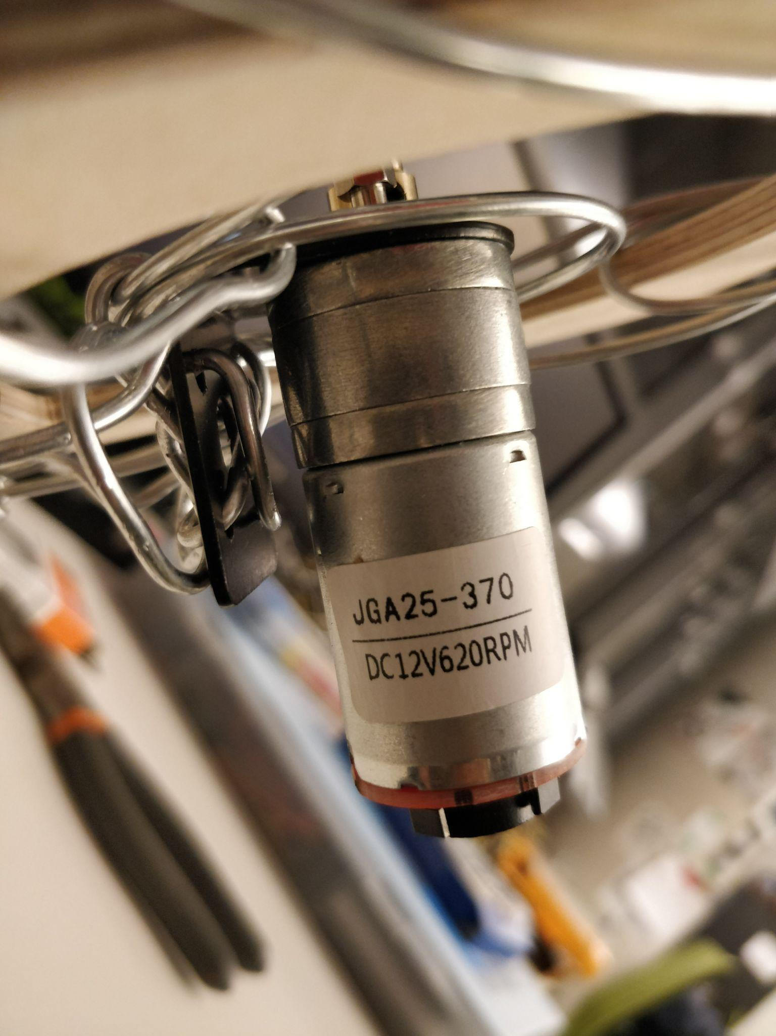
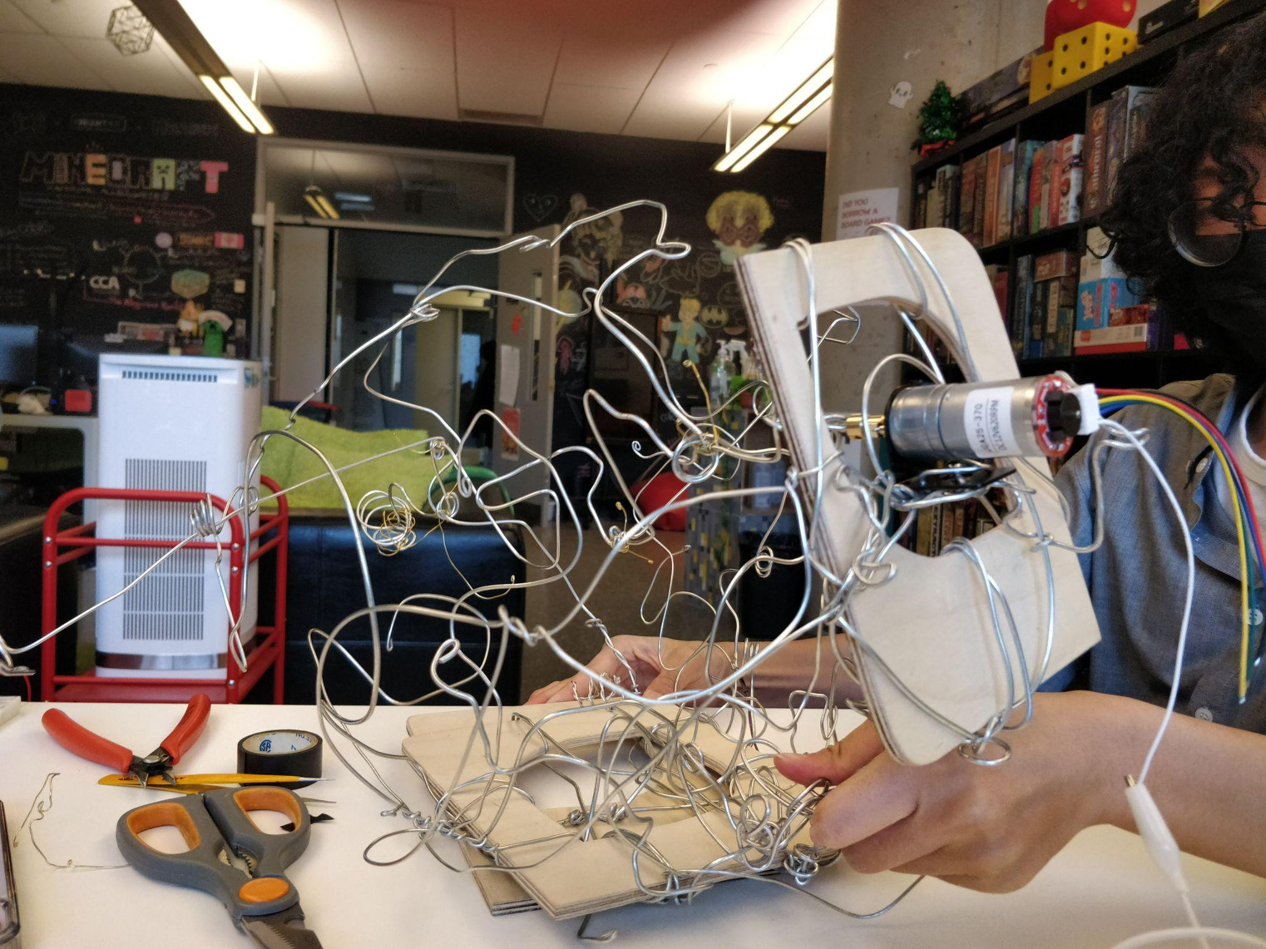

Slide 21
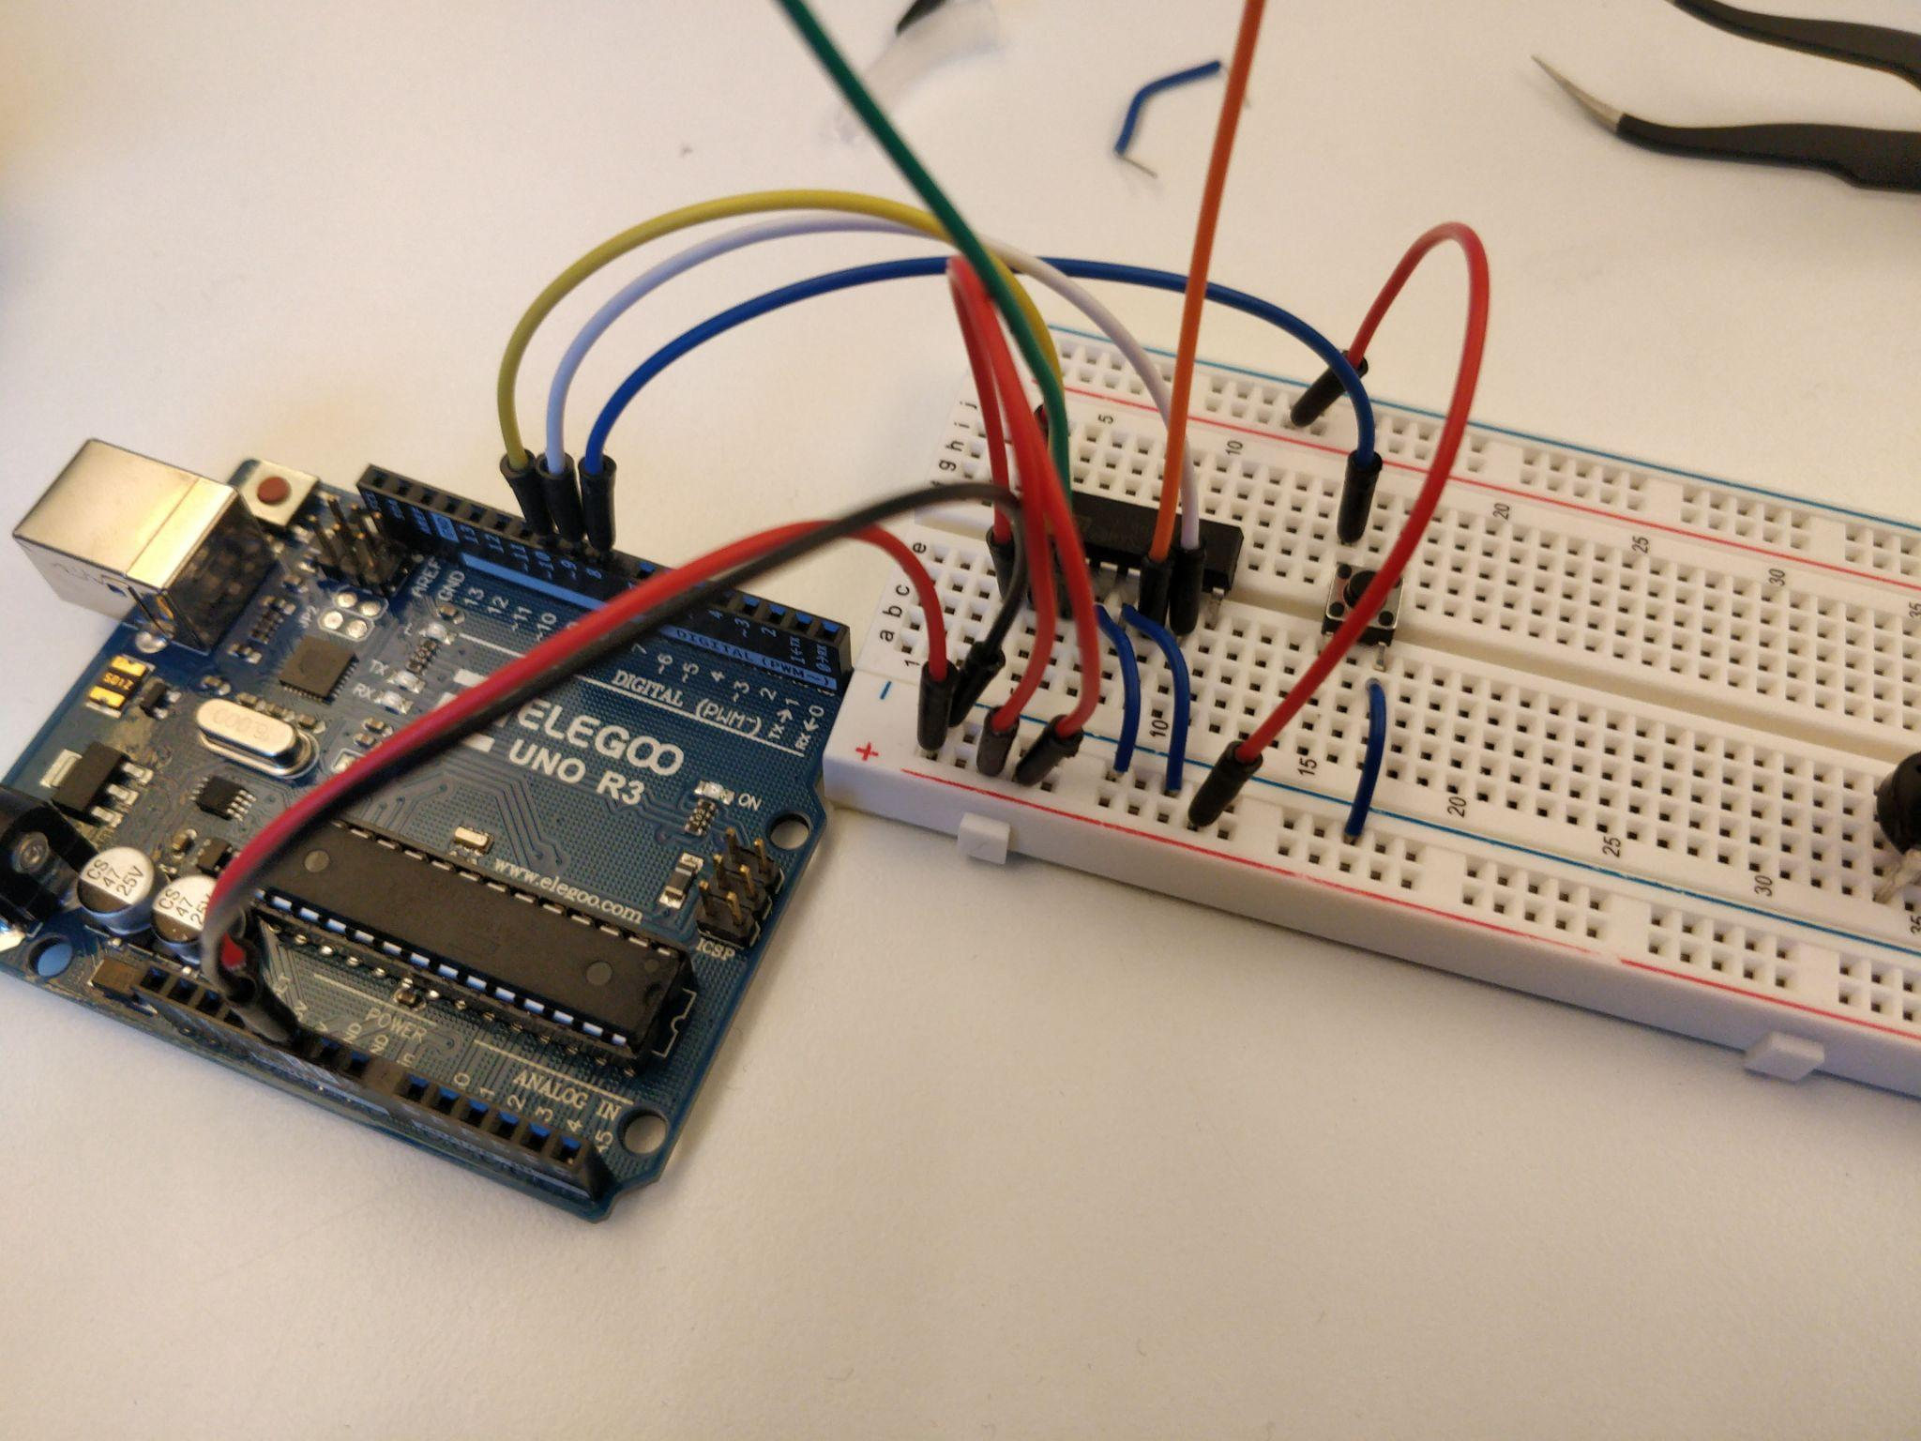
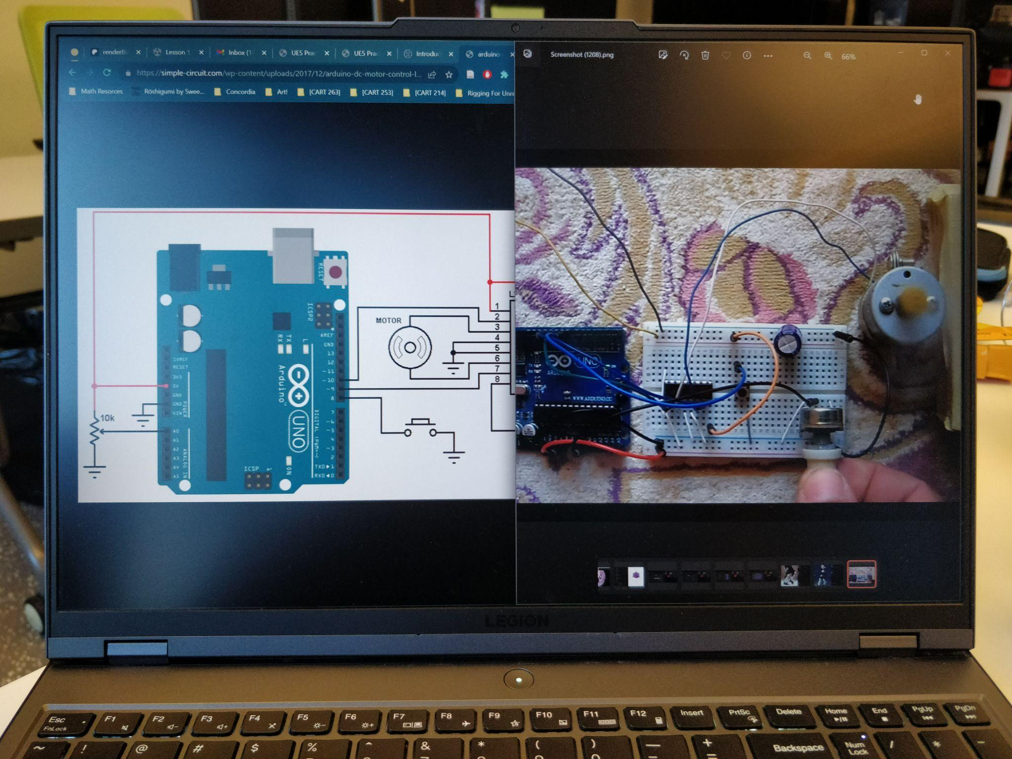

Slide 22
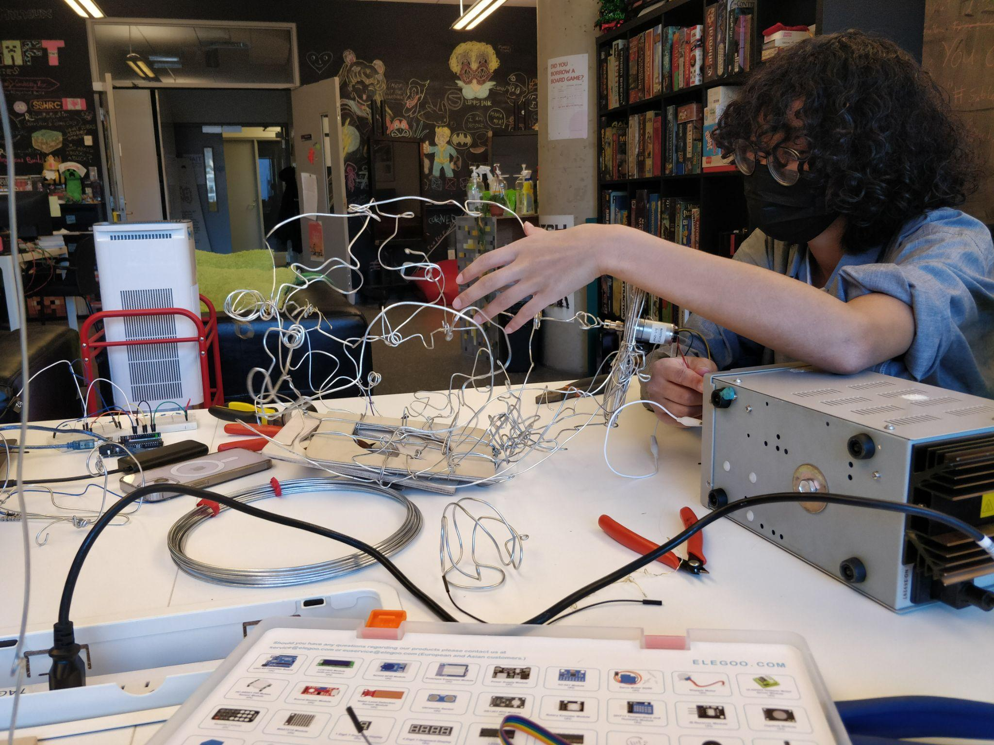

Slide 23
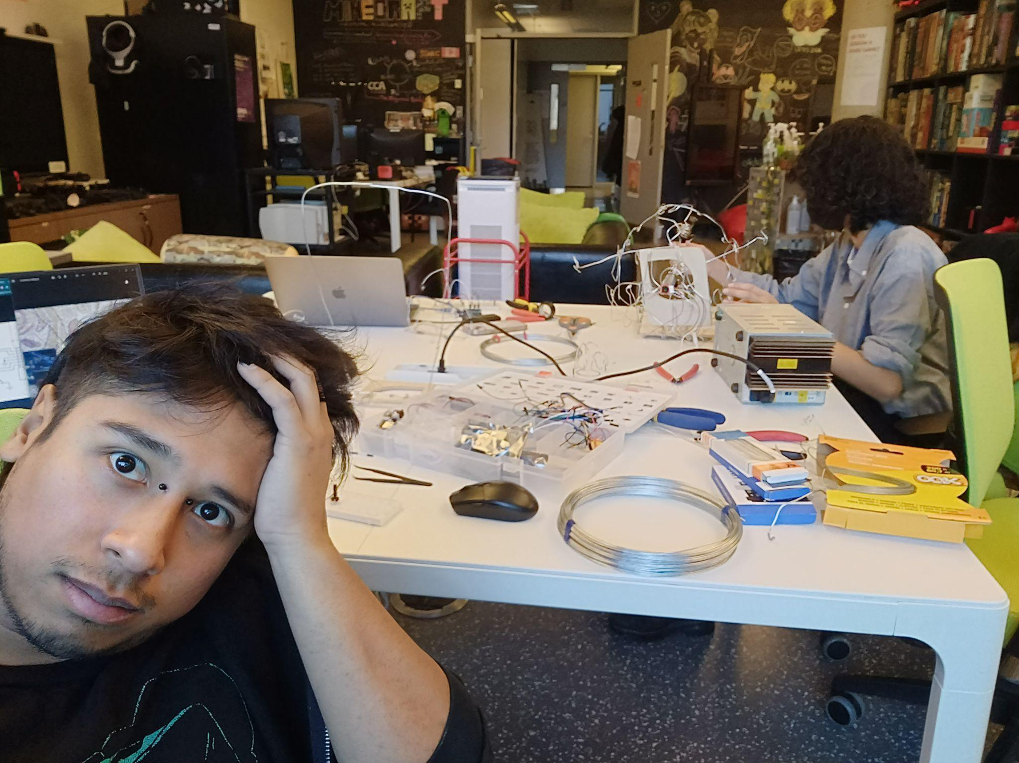
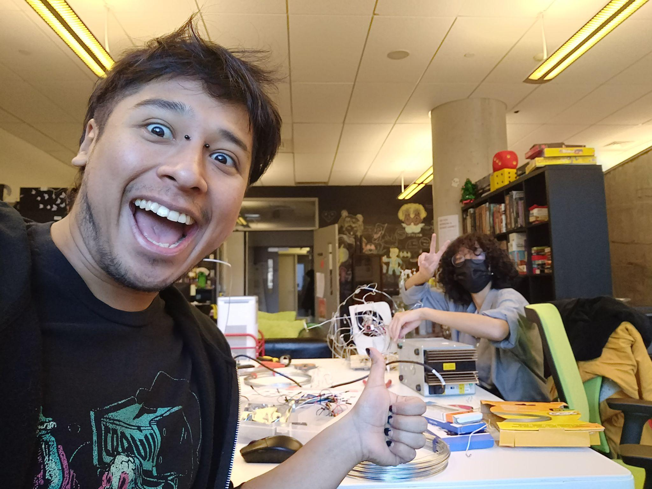

Slide 24
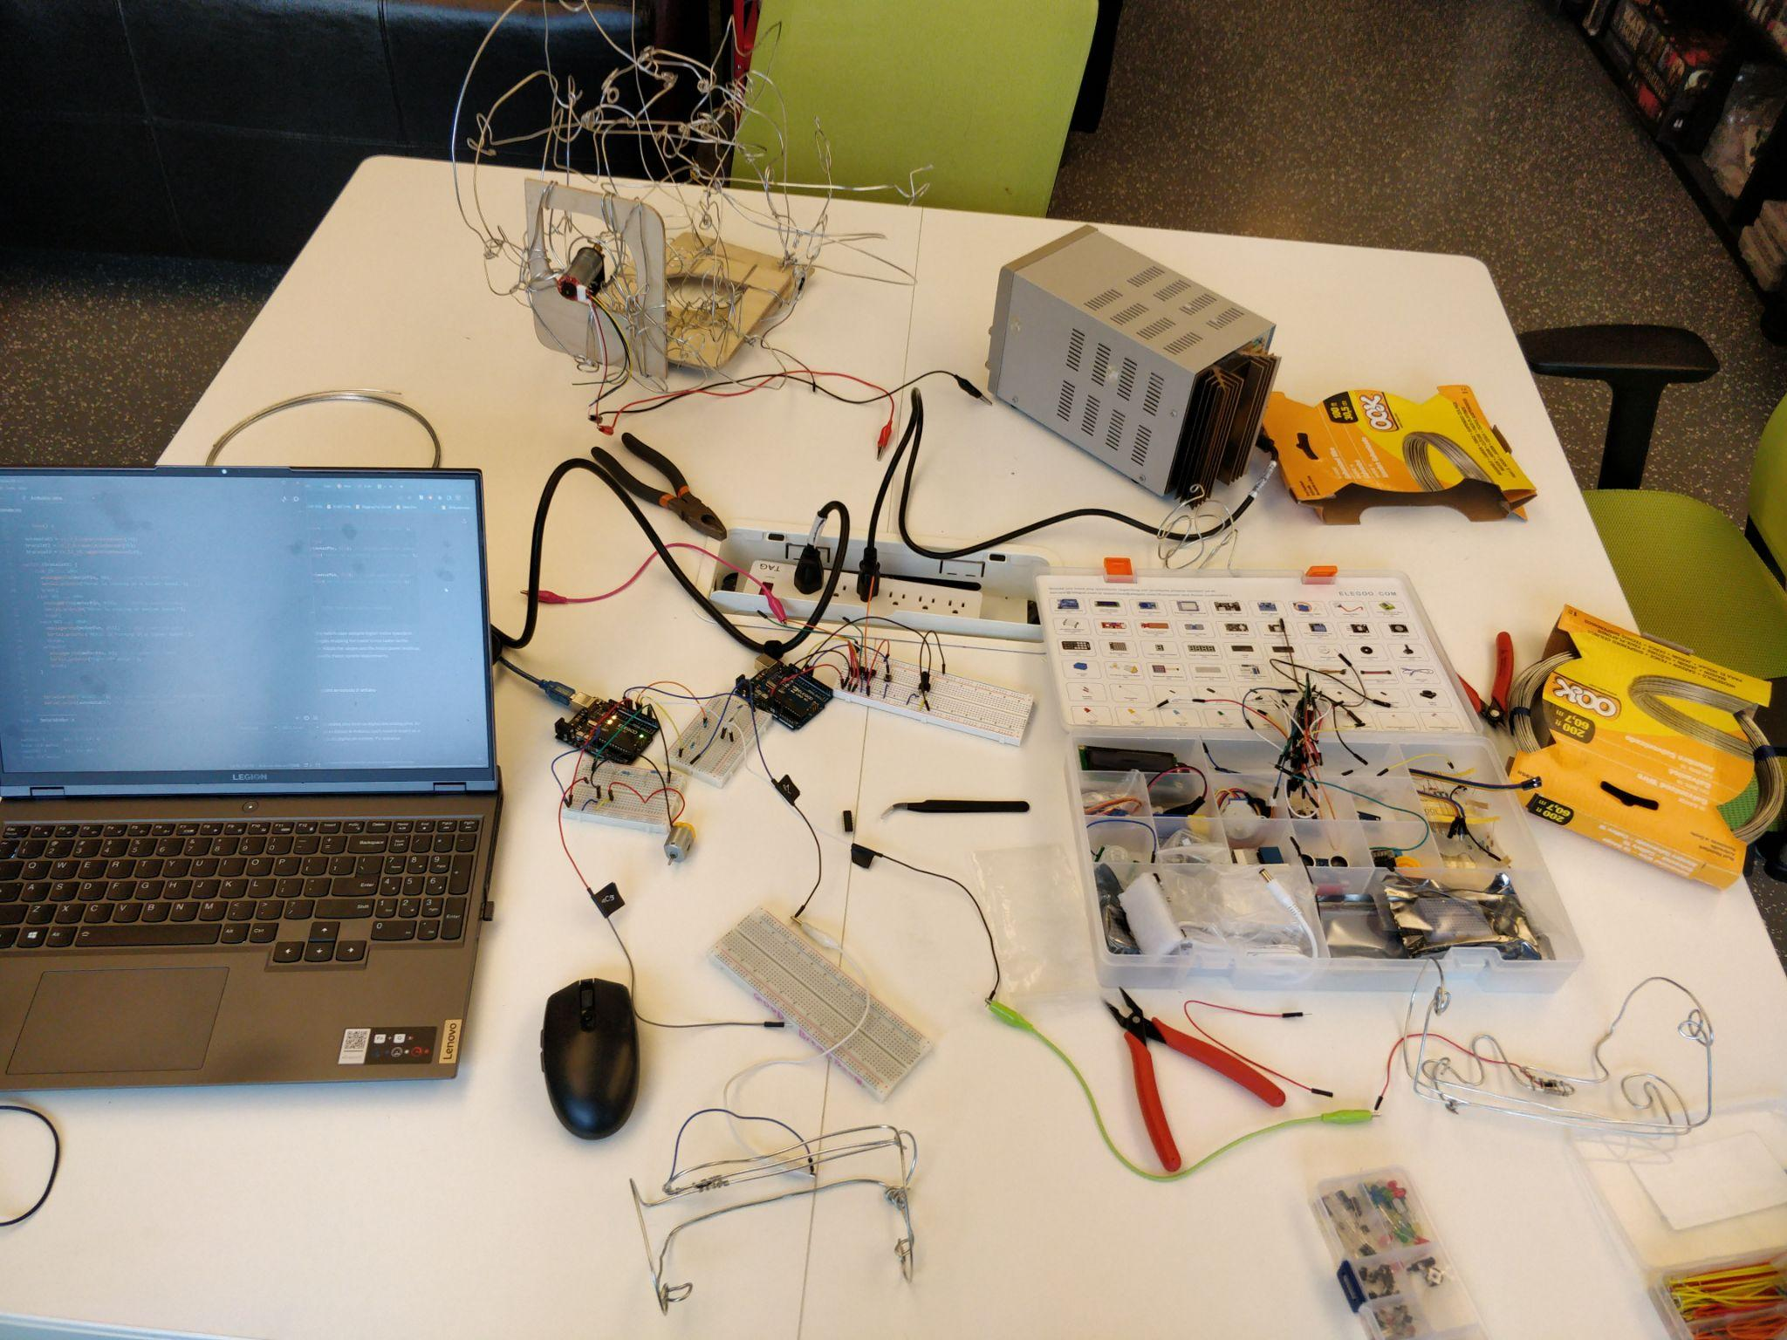

Slide 25
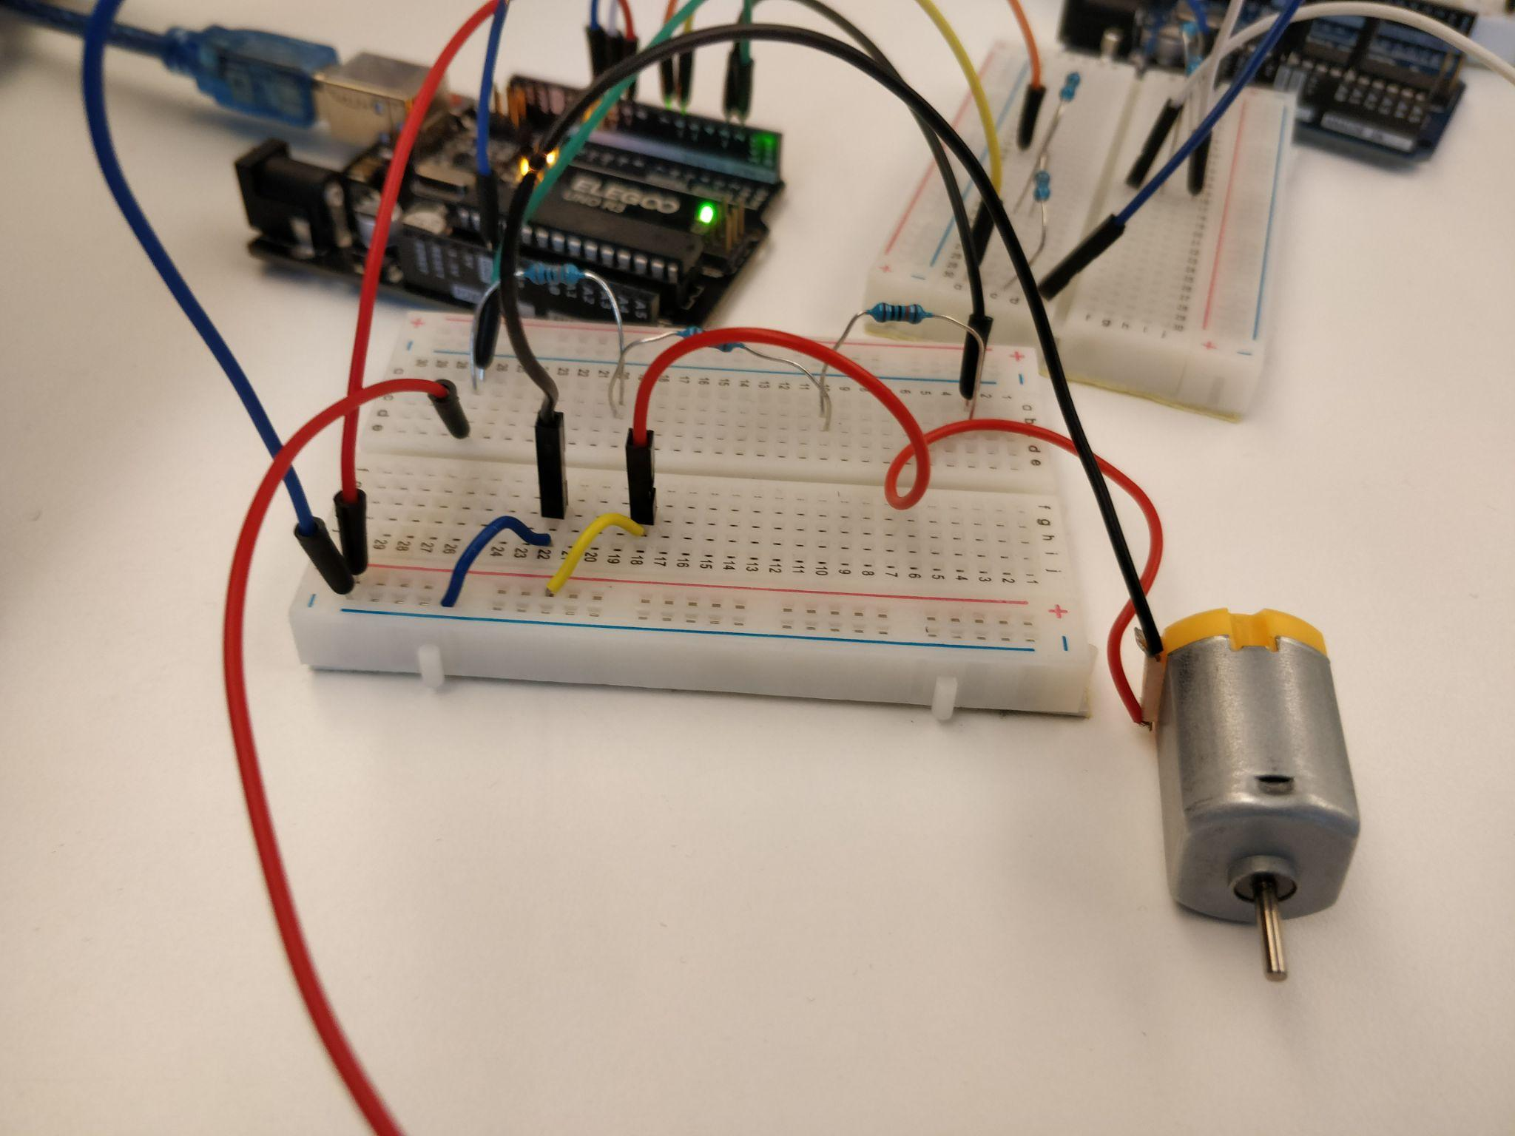
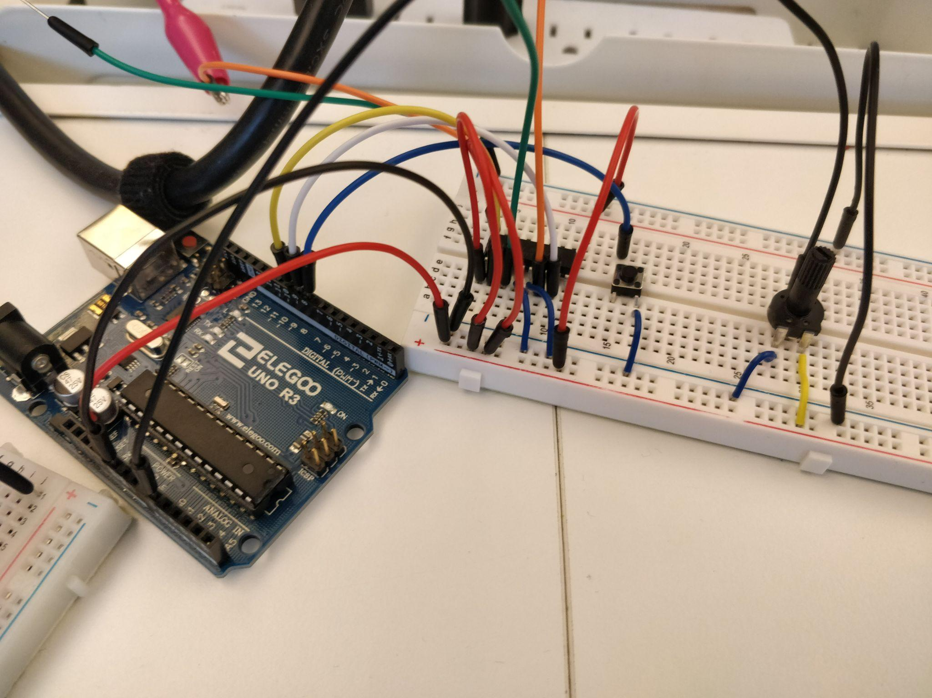

Slide 26
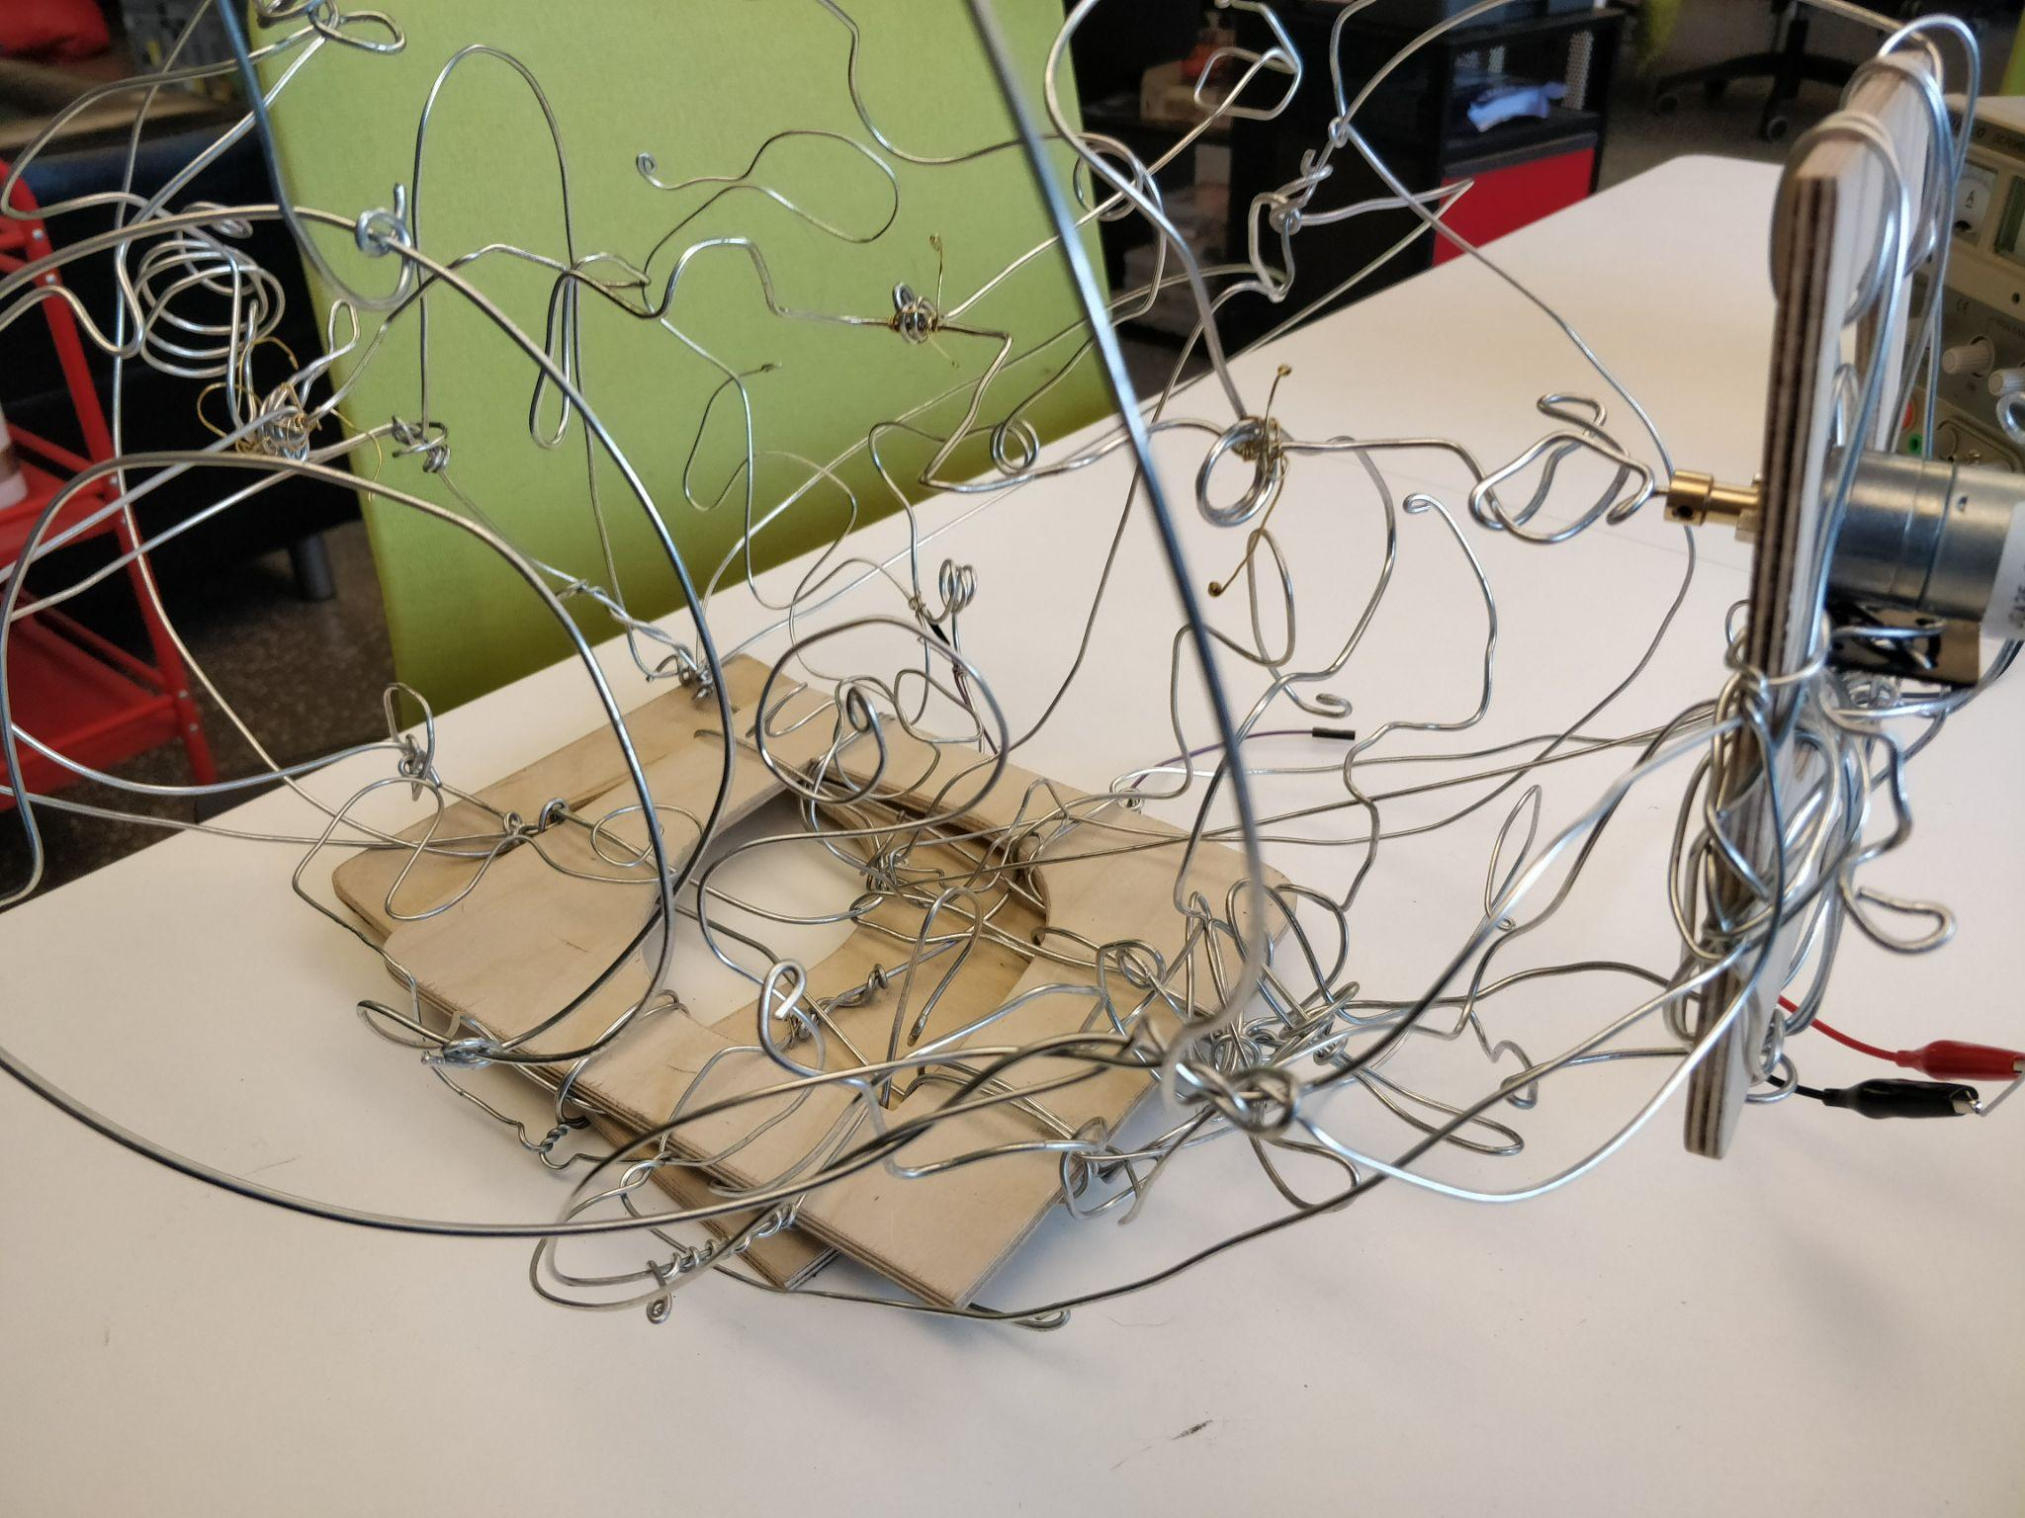

Slide 27
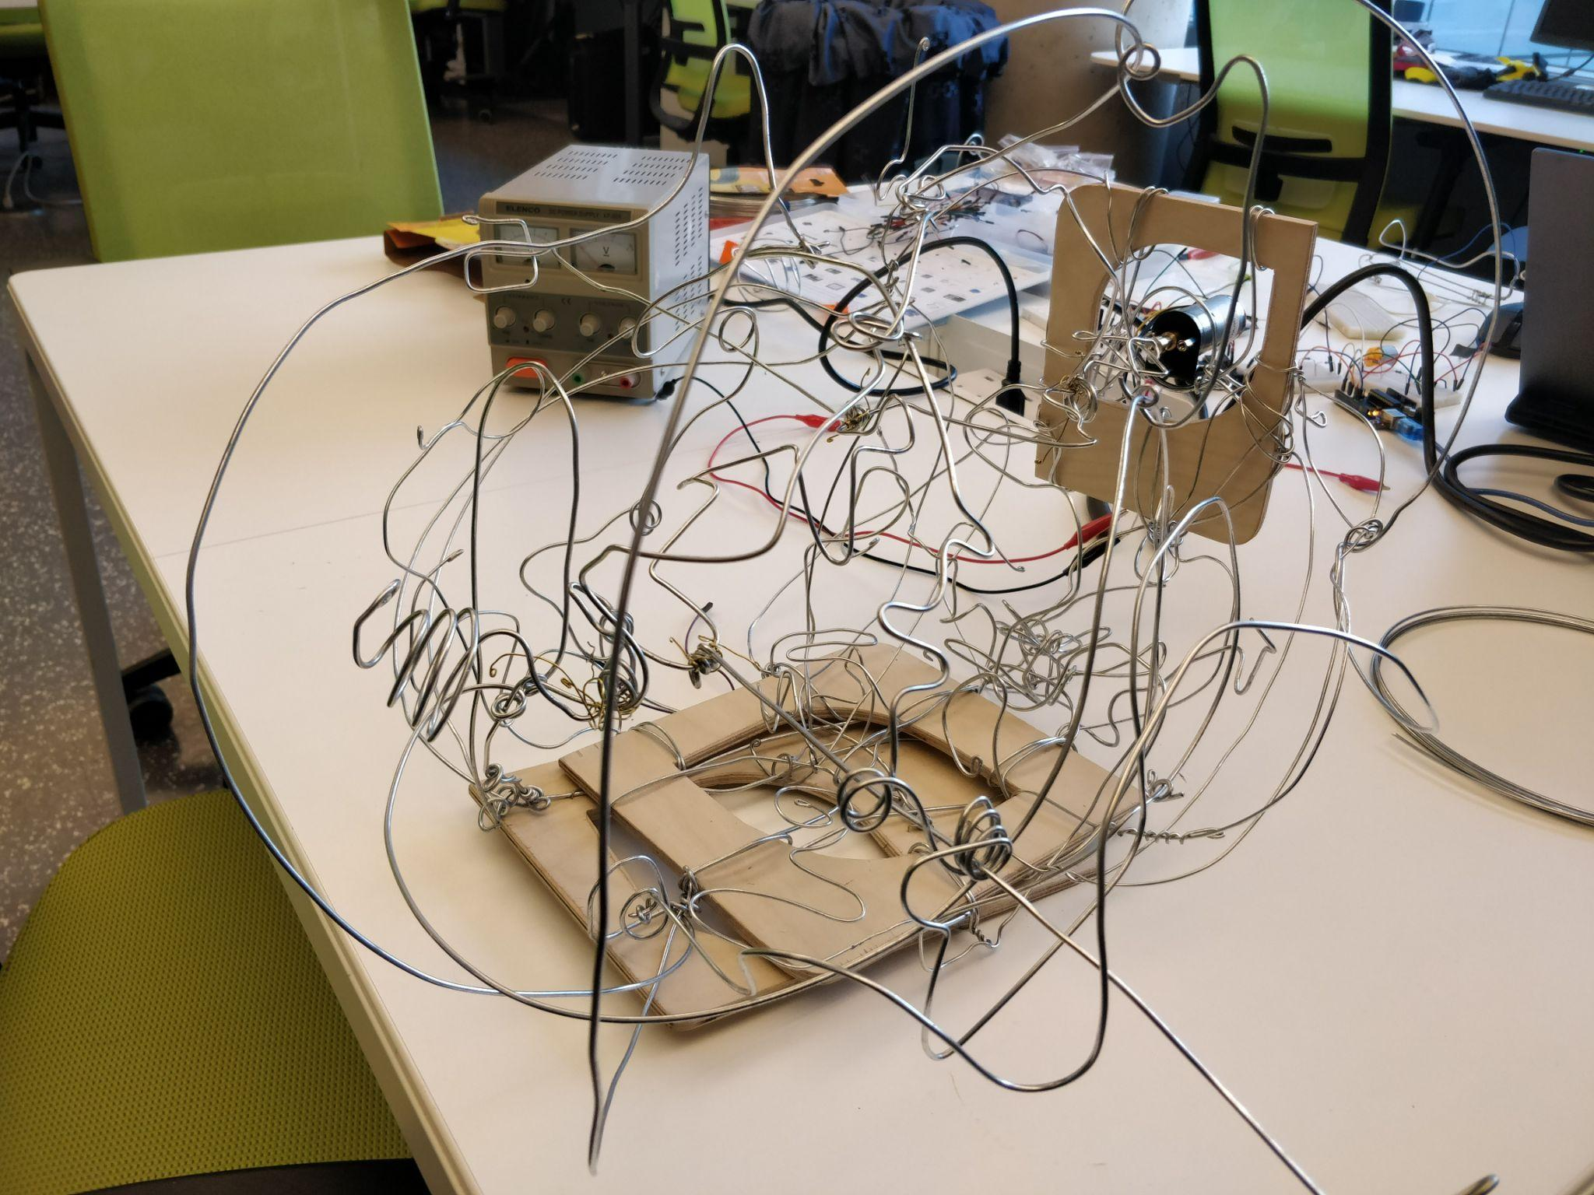

Slide 28
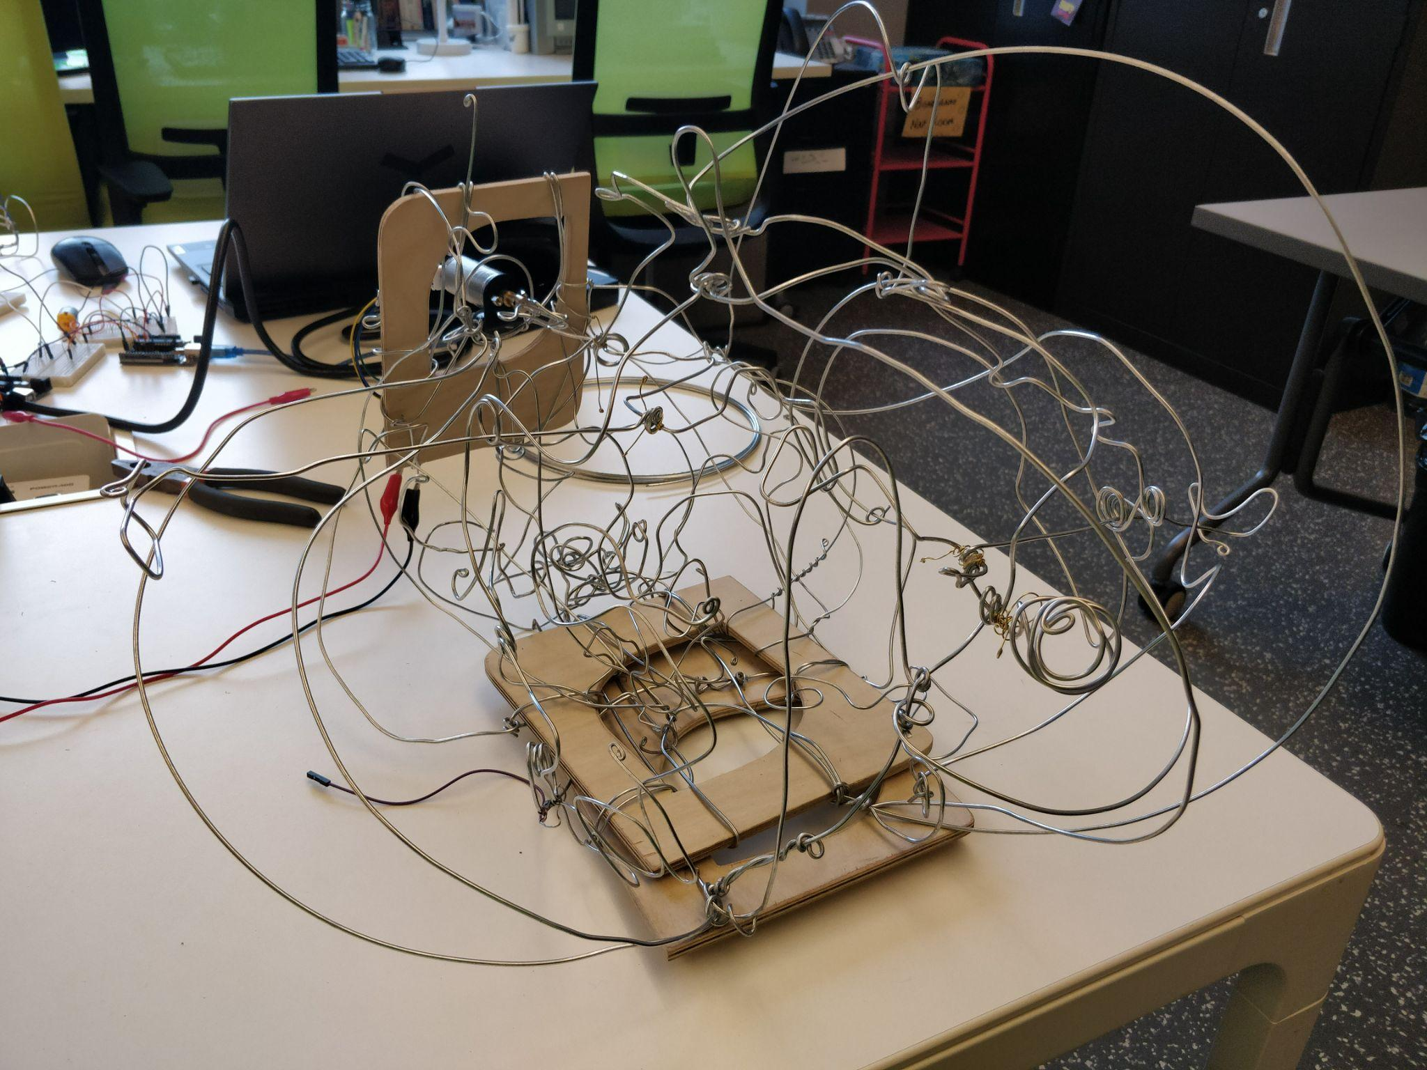

Slide 29
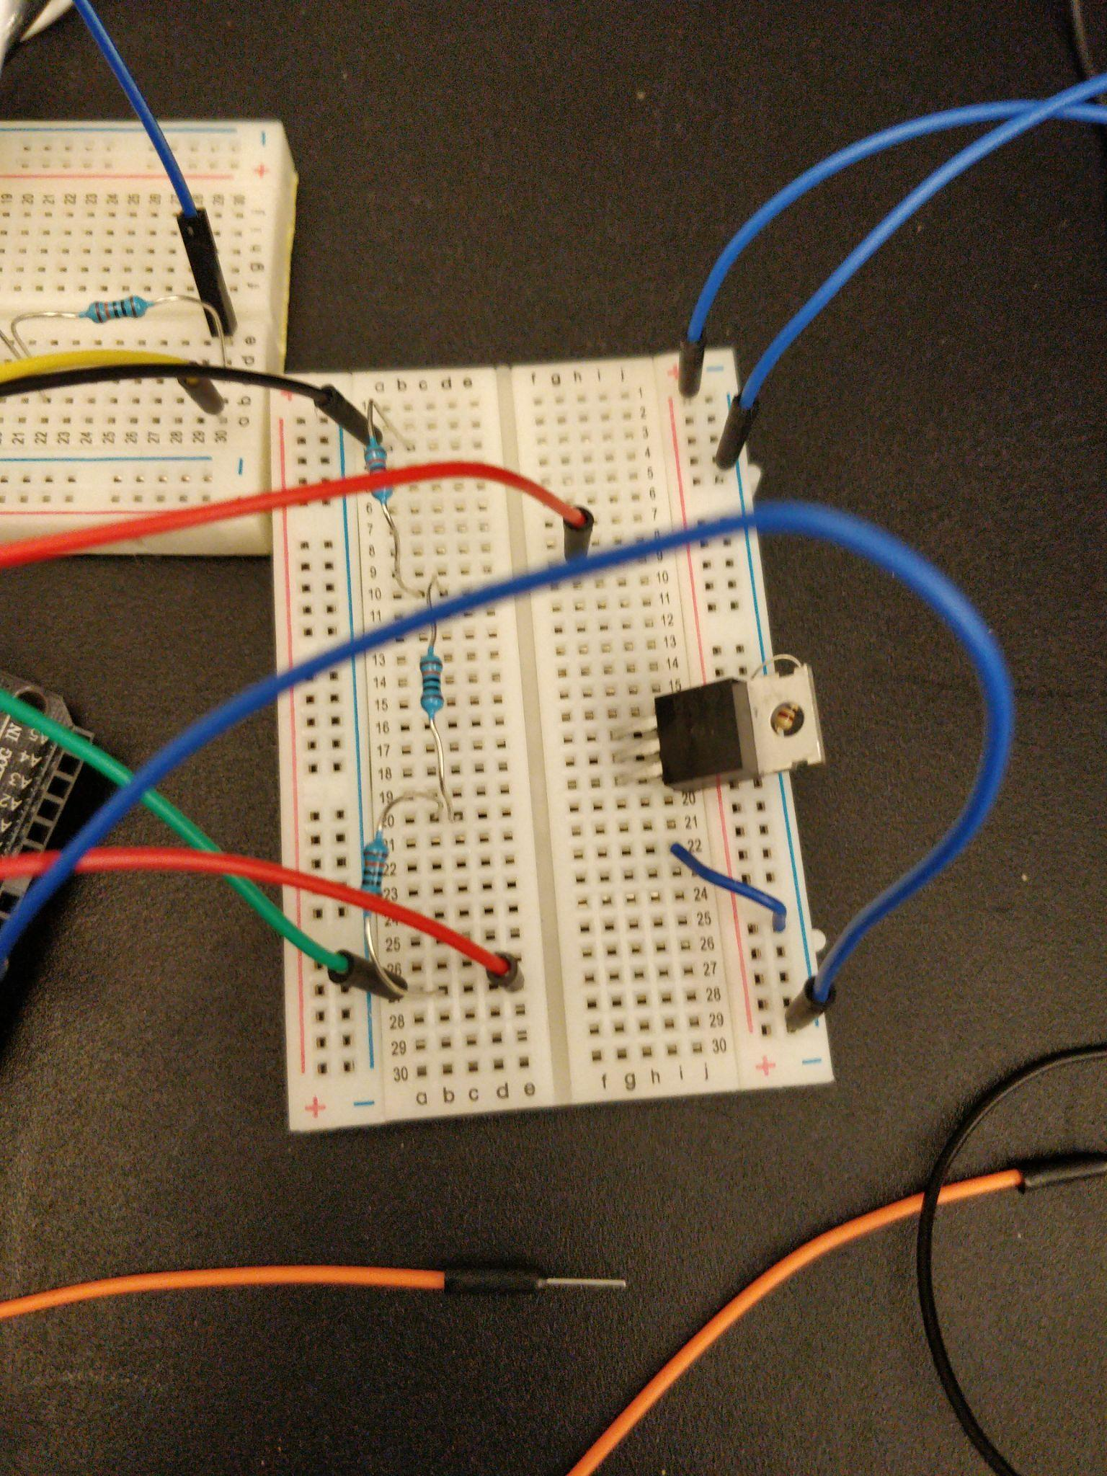
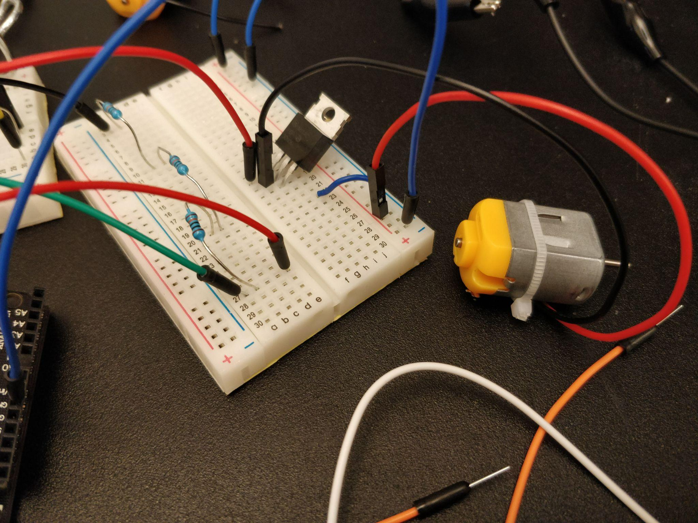

Slide 30
